Slide 1
Work Health and Safety
Awareness for Supervisors
April 2017

Slide 2
The Mining and Quarrying Occupational Health and Safety Committee
Promoting Work Health and Safety in the Workplace
This workplace industry safety presentation is developed and fully funded by the Mining and Quarrying Occupational Health and Safety Committee (MAQOHSC).
ISBN 978-1-925361-38-4

Slide 3
Disclaimer
IMPORTANT: The information in this presentation is of a general nature, and should not be relied upon as individual professional advice. If necessary, legal advice should be obtained from a legal practitioner with expertise in the field of Work Health and Safety law (SA).
Although every effort has been made to ensure that the information in this presentation is complete, current and accurate, the Mining and Quarrying Occupational Health and Safety Committee, any agent, author, contributor or the South Australian Government, does not guarantee that it is so, and the Committee accepts no responsibility for any loss, damage or personal injury that may result from the use of any material which is not complete, current and accurate.
Users should always verify historical material by making and relying upon their own separate inquiries prior to making any important decisions or taking any action on the basis of this information.

Slide 4
Creative Commons
This creative commons licence allows you to copy, communicate and or adapt our work for non-commercial purposes only, as long as you attribute the work to Mining and Quarrying Occupational Health and Safety Committee and abide by all the other licence terms therein.

Slide 5
Objective
To provide you with an understanding of Work Health and Safety legislation.
At the end of this session participants will:
Have a greater understanding of Work Health and Safety legislation and its requirements.

Slide 6
Welcome
It is a serious responsibility to take on a position of supervisor in any organisation. It is not always an easy job and there will be times you will have to make the hard decisions and have uneasy conversations.
An organisation’s success relies heavily on ensuring all involved have a clear understanding of their responsibilities and accountabilities. This is particularly important when it comes to protecting the health and safety of those in the workforce, be they employees or contractors. Additionally there is a requirement to ensure that no harm is done to the environment or the community in which you work.
In order to achieve business goals an organisation’s leaders and supervisors must ‘lead by example’ and work within and clearly understand company policies, procedures and standards of work. Strong leadership is the key to an effective safety culture.
If the standards set out in workplace health, safety and environment policies and associated documents are followed, and everyone remains aware of the commitment to continuously improve, the goal of zero harm to everyone and safe execution of everything we do will follow.

Slide 7
Work Health and Safety Legislation
The main legislation covering Work Health and Safety in South Australia is comprised of the:
Work Health and Safety Act 2012 (SA)
Work Health and Safety Regulations 2012 (SA)
Approved Codes of Practice cited in legislation are mandatory, otherwise should be used as a minimum requirement.

Slide 8
Work Health and Safety Framework
Work Health and Safety Act
Work Health and Safety Regulations
Codes of Practice
Australian Standards
Industry standards
Guidance material

Slide 9
Legislative Hierarchy
The Act provides a framework to protect the health, safety and welfare of all workers at work and of all other people who might be affected by the work.
The Regulations specify the way in which some duties under the Act must be met and prescribes procedural or administrative requirements to support the Act (for example requiring licences for specific activities and the keeping of records).
Approved Codes of Practice provide practical guidance on how to meet the standards set out in the Act and the Regulations. Codes of Practice are admissible in proceedings as evidence of whether or not a duty under the Work Health and Safety laws has been met. They can also be referred to by an inspector when issuing an improvement or prohibition notice.
Standards and industry guidelines

Slide 10
Work Health and Safety Act
The main object of the model Act is:
to provide for a balanced and nationally consistent framework to secure the health and safety of workers and workplaces.
Notes:
This is to be achieved by;
protecting workers and other persons against harm to their health, safety and welfare through the elimination or minimisation of risks arising from work or from specified types of substances or plant; and
providing for fair and effective workplace representation, consultation, co-operation and issue resolution in relation to work health and safety; and
encouraging unions and employer organisations to take a constructive role in promoting improvements in work health and safety practices, and assisting persons conducting businesses or undertakings and workers to achieve a healthier and safer working environment; and
promoting the provision of advice, information, education and training in relation to work health and safety; and
securing compliance with this Act through effective and appropriate compliance and enforcement measures; and
ensuring appropriate scrutiny and review of actions taken by persons exercising powers and performing functions under this Act; and
providing a framework for continuous improvement and progressively higher standards of work health and safety; and
maintaining and strengthening the national harmonisation of laws relating to work health and safety and to facilitate a consistent national approach to work health and safety in this jurisdiction.

Slide 11
Key changes in terms from OHS
Occupational Health and Safety (OHS)
Employer
Employee
OHS Representative
OHS Committee
Managers and Directors
Work Health and Safety (WHS)
Person Conducting a Business or Undertaking (PCBU)
Worker (includes contractors, volunteers)
Health and Safety Representative
Health and Safety Committee
Officer

Slide 12
Legislative requirements
The Work Health and Safety Act 2012 (SA)
Section 17 - Management of risks
A duty imposed on a person to ensure health and safety requires the person -
to eliminate risks to health and safety, so far as is reasonably practicable
if it is not reasonably practicable to eliminate risks to health and safety, to minimise those risks so far as is reasonably practicable.
A person must comply with subsection (1) to the extent to which the person has the capacity to influence and control the matter or would have that capacity but for an agreement or arrangement purporting to limit or remove that capacity.

Slide 13
Duties
Persons with duties under the Work Health and Safety Act 2012 (SA):
PCBUs including manufacturers, suppliers, importers or persons with management or control of workplaces, fixtures and fittings
PCBUs who install, commission or construct plant, structures or substances
Self-employed persons
Workers
Officers
Others at the workplace.
Notes:
15—Person may have more than one duty
A person can have more than one duty by virtue of being in more than one class of duty holder.
16—More than one person can have a duty
More than one person can concurrently have the same duty.
Each duty holder must comply with that duty to the standard required by this Act even if another duty holder has the same duty.
If more than one person has a duty for the same matter, each person—
retains responsibility for the person's duty in relation to the matter; and
must discharge the person's duty to the extent to which the person has the capacity to influence and control the matter or would have had that capacity but for an agreement or arrangement purporting to limit or remove that capacity.

Slide 14
What is “Reasonably Practicable”
The Work Health and Safety Act 2012 (SA)
Section 18 - What is reasonably practicable in ensuring health and safety
A guiding principle of the Act is that all people are given the highest level of health and safety protection from hazards arising from work, so far as is reasonably practicable.
The term ‘reasonably practicable’ means what could reasonably be done at a particular time to ensure health and safety measures are in place.

Slide 15
What is “Reasonably Practicable”
In determining what is reasonably practicable, there is a requirement to weigh up all relevant matters including:
The likelihood of a hazard or risk occurring (in essence the probability of a person being exposed to harm)
The degree of harm that might result if the hazard or risk occurred (in essence the potential seriousness of injury or harm)
What the person concerned knows, or ought to reasonably know, about the hazard or risk and ways of eliminating or minimising it
The availability of suitable ways to eliminate or minimise the hazard or risk
The cost of eliminating or minimising the hazard or risk.

Slide 16
Legislative requirements
The Work Health and Safety Act 2012 (SA)
Section 19 - Primary duty of care
A person conducting a business or undertaking must ensure, so far as is reasonably practicable, the health and safety of:
Workers engaged, or caused to be engaged by the person
Workers whose activities in carrying out work are influenced or directed by the person, while the workers are at work in the business or undertaking.

Slide 17
Work Health and Safety Act 2012 (SA)
A person conducting a business or undertaking must ensure, so far as is reasonably practicable, that the health and safety of other persons is not put at risk from work carried out as part of the conduct of the business or undertaking.
A person conducting a business or undertaking must ensure, so far as is reasonably practicable
The provision and maintenance of a work environment without risks to health and safety
The provision and maintenance of safe plant and structures
The provision and maintenance of safe systems of work.

Slide 18
Work Health and Safety Act 2012 (SA)
The safe use, handling and storage of plant, structures and substances
The provision of adequate facilities for the welfare at work of workers in carrying out work for the business or undertaking, including ensuring access to those facilities
The provision of any information, training, instruction or supervision that is necessary to protect all persons from risks to their health and safety arising from work carried out as part of the conduct of the business or undertaking
That the health of workers and the conditions at the workplace are monitored for the purpose of preventing illness or injury of workers arising from the conduct of the business or undertaking.

Slide 19
Legislative requirements
The Work Health and Safety Act 2012 (SA)
Section 28 - Duties of workers
While at work, workers must take reasonable care for their own health and safety and that of others who may be affected by their actions or omissions. They must also:
Comply, so far as they are reasonably able, with any reasonable instruction given by the PCBU to allow the PCBU to comply with Work Health and Safety laws
Cooperate with any reasonable policy or procedure of the PCBU relating to health or safety at the workplace that has been notified to workers.

Slide 20
Legislative requirements
Work Health and Safety Regulations 2012 (SA)
Regulation 34 - Duty to identify hazards
A duty holder, in managing risks to health and safety, must identify reasonably foreseeable hazards that could give rise to risks to health and safety.
Regulation 35 - Managing risks to health and safety
A duty holder, in managing risks to health and safety, must:
Eliminate risks to health and safety so far as is reasonably practicable
If it is not reasonably practicable to eliminate risks to health and safety - minimise those risks so far as is reasonably practicable.

Slide 21
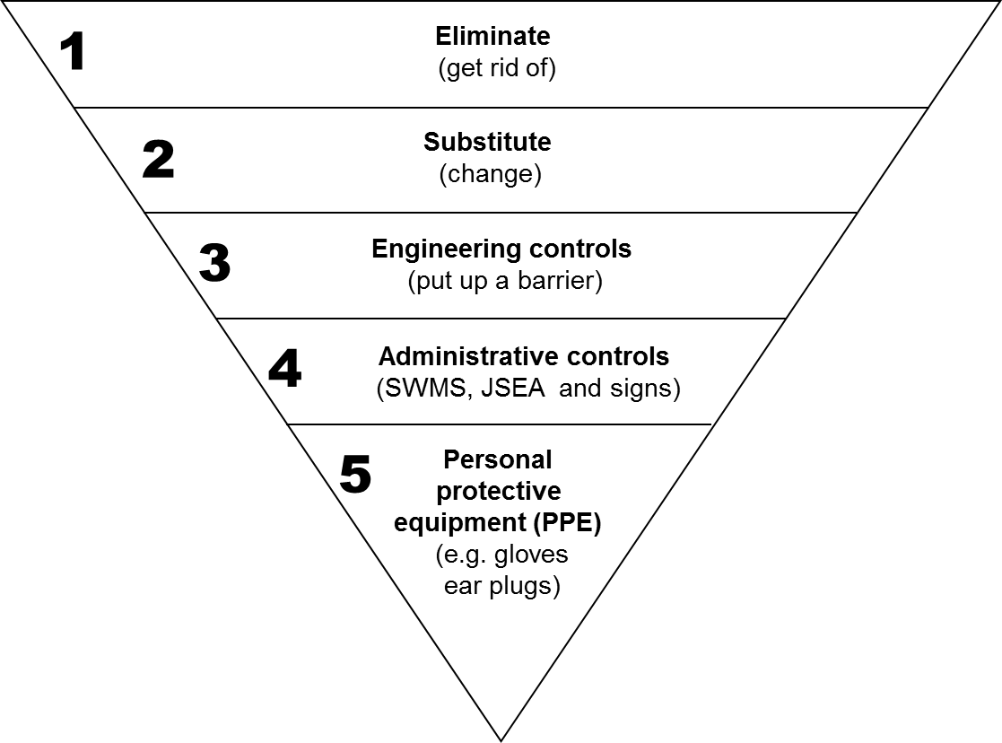
Legislative requirements
Work Health and Safety Regulations 2012 (SA)
Regulation 36 - Hierarchy of control measures
rely on the person working with the hazards / risks ‘doing the right thing’

Slide 22
Legislative requirements
Work Health and Safety Regulations 2012 (SA)
Regulation 37 - Maintenance of control measures
A duty holder who implements a control measure to eliminate or minimise risks to health and safety must ensure that the control measure is, and is maintained so that it remains, effective, including by ensuring that the control measure is and remains -
Fit for purpose
Suitable for the nature and duration of the work
Installed, set up and used correctly.

Slide 23
Legislative requirements
Work Health and Safety Regulations 2012 (SA)
Regulation 38 - Review of control measures
A duty holder must review and, as necessary, revise control measures implemented under the regulations so as to maintain, so far as is reasonably practicable, a work environment that is without risks to health or safety.
Notes:
38—Review of control measures
A duty holder must review and, as necessary, revise control measures implemented under these regulations so as to maintain, so far as is reasonably practicable, a work environment that is without risks to health or safety.
Without limiting subregulation (1), the duty holder must review and, as necessary, revise a control measure in the following circumstances:
the control measure does not control the risk it was implemented to control so far as is reasonably practicable;
Examples—
The results of monitoring show that the control measure does not control the risk.
A notifiable incident occurs because of the risk.
before a change at the workplace that is likely to give rise to a new or different risk to health or safety that the measure may not effectively control;
a new relevant hazard or risk is identified;
the results of consultation by the duty holder under the Act or these regulations indicate that a review is necessary;
a health and safety representative requests a review under subregulation (4).
Without limiting subregulation (2)(b), a change at the workplace includes—
a change to the workplace itself or any aspect of the work environment; or
a change to a system of work, a process or a procedure.
A health and safety representative for workers at a workplace may request a review of a control measure if the representative reasonably believes that—
a circumstance referred to in subregulation (2)(a), (b), (c) or (d) affects or may affect the health and safety of a member of the work group represented by the health and safety representative; and
the duty holder has not adequately reviewed the control measure in response to the circumstance.

Slide 24
Supervisors Role
Supervisors are key personnel involved in the management of workers and as such have a higher duty of care relating to:
Knowledge
Training
Experience
Position related responsibilities.

Slide 25
Supervisor Responsibilities
Supervisors control the day-to-day work undertaken and have a duty to ensure:
Work is undertaken in accordance with existing health and safety policies and procedures
All risks to health and safety are effectively controlled
Appropriate levels of training and supervision are provided for the workgroup, particularly for new or inexperienced workers.

Slide 26
Supervisor Responsibilities continued
Training and Instruction
Ensure:
Appropriate levels of supervision are provided to new and existing workers
That all workers are trained to perform their tasks competently.
Work Health and Safety Issues
Ensure:
A prompt and appropriate response when advised of Work Health and Safety issues
Incident is effectively managed. e.g. the welfare of injured persons and safety of others is taken care of, and the investigation process is commenced.

Slide 27
Supervisor Responsibilities continued
Maintenance
Ensure:
General work area is maintained in a safe condition
Plant and equipment is maintained in a safe condition
Risk controls are appropriately maintained.

Slide 28
Supervisor Responsibilities continued
Implement policies and procedures
Consult with management, health and safety representatives and workers
Conduct regular workplace inspections
Assess risks and implement controls in consultation with the workgroup
Ensure suitable personal protective equipment (PPE) is provided, used and maintained
Ensure that any identified hazards are eliminated or minimised as far as is reasonable practicable.

Slide 29
Further Assistance
MAQOHSC Work Health and Safety Specialists are available to provide further on-site support and assistance on all Work Health and Safety matters.
MAQOHSC Work Health and Safety Specialists can be contacted via our online support request form available on our website at www.maqohsc.sa.gov.au or email maqohsc@sa.gov.au.
Work Health and Safety Legislation, Codes of Practice, fact sheets, Health and Safety Representatives (HSR) information and guides can be found at the following websites:
SafeWork SA – www.safework.sa.gov.au or call 1300 365 255
Safe Work Australia – www.safeworkaustralia.gov.au or call 1300 551 832

