Slide 1
Emergency Management
April 2017

Slide 2
The Mining and Quarrying Occupational Health and Safety Committee
Promoting Work Health and Safety in the Workplace
This workplace industry safety presentation is developed and fully funded by the Mining and Quarrying Occupational Health and Safety Committee (MAQOHSC).
ISBN 978-1-925361-49-0

Slide 3
Disclaimer
IMPORTANT: The information in this presentation is of a general nature, and should not be relied upon as individual professional advice. If necessary, legal advice should be obtained from a legal practitioner with expertise in the field of Work Health and Safety law (SA).
Although every effort has been made to ensure that the information in this presentation is complete, current and accurate, the Mining and Quarrying Occupational Health and Safety Committee, any agent, author, contributor or the South Australian Government, does not guarantee that it is so, and the Committee accepts no responsibility for any loss, damage or personal injury that may result from the use of any material which is not complete, current and accurate.
Users should always verify historical material by making and relying upon their own separate inquiries prior to making any important decisions or taking any action on the basis of this information.

Slide 4
Creative Commons
This creative commons licence allows you to copy, communicate and or adapt our work for non-commercial purposes only, as long as you attribute the work to Mining and Quarrying Occupational Health and Safety Committee and abide by all the other licence terms therein.

Slide 5
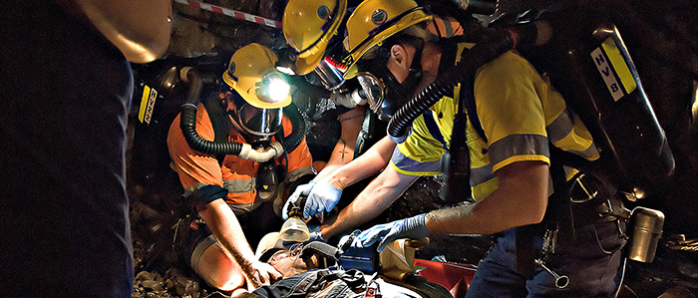
Emergency Management

Slide 6
Emergency Management
Emergency management is the organisation and management of resources and responsibilities for dealing with all aspects of emergencies, particularly preparedness, response and rehabilitation.
Emergency management involves the establishment of plans, structures and arrangements to respond to a variety of emergency situations in a coordinated way.
It is the responsibility of the person conducting a business or undertaking (PCBU) for ensuring the framework to reduce an organisations vulnerability to hazards and cope with emergencies.

Slide 7
Legislation
Work Health and Safety Act 2012 (SA)
Section 19 - Primary Duty of Care
A PCBU must ensure, so far as is reasonably practicable, the provision and maintenance of:
a work environment without risks to health and safety; and
safe plant, structures and safe systems of work; and
  the safe use, handling and storage of plant, structures and substances; and
  adequate facilities to support the welfare of workers; and
  monitoring of the health of workers and conditions at the workplace to prevent illness or injury of workers; and
  any information, training, instruction or supervision that is necessary to protect all persons from risks to their health and safety.

Slide 8
Legislation
Work Health and Safety Regulations 2012 (SA) - General
Regulation 43 - Duty to prepare, maintain and implement emergency plan
A PCBU must ensure that an emergency plan is prepared for the workplace, that provides:
emergency procedures, including:
  an effective response to an emergency; and
  evacuation procedures; and
  notifying emergency service organisations at the earliest opportunity; and
  medical treatment and assistance; and
  effective communication between the person authorised by the PCBU to coordinate the emergency response and all persons at the workplace;

Slide 9

Legislation
emergency procedures continued
procedures for testing emergency procedures, including the frequency of testing;
information, training and instruction to relevant workers in relation to implementing the emergency procedures.

Slide 10
Legislation
A PCBU must maintain the emergency plan for the workplace so that it remains effective and takes into account:
the nature of the work being carried out and the hazards at the workplace;
the size and location of the workplace; and
the number and composition of the workers and other persons at the workplace.
A PCBU must implement the emergency plan for the workplace in the event of an emergency.

Slide 11
Legislation
Work Health and Safety Regulations 2012 (SA)
Chapter 10 - Emergency plans for all mines
Regulation 664 - Duty to prepare emergency plan
The mine operator of a mine must prepare an emergency plan for the mine including all matters required by Regulation 43(1).
The mine emergency plan must address all aspects of emergency response by ensuring:
  the establishment of a system that enables all persons at the mine to be promptly located; and
  the provision of adequate rescue equipment; and

Slide 12
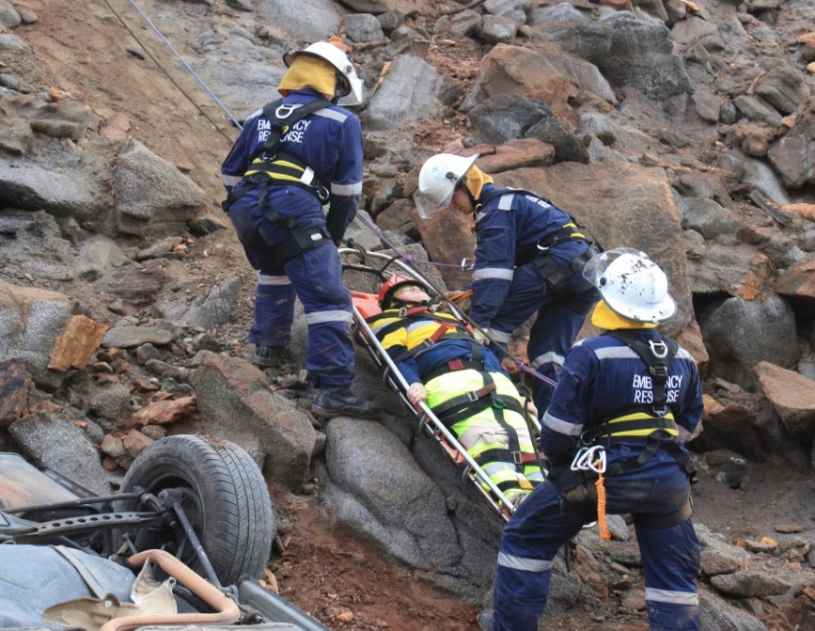
Legislation
Prepare an emergency plan continued
  that an adequate number of persons trained in the use of rescue equipment are available to respond effectively to the emergency if a person is working at the mine; and
  the provision of adequate patient transport if a person is working at a mine; and

Slide 13
Legislation
Prepare an emergency plan continued
include all matters specified in Schedule 22; and
so far as is reasonably practicable, be set out and expressed in a way that is readily understandable by persons who use it.
The emergency plan for a mine must comply with Regulation 664 2(a) and (b) and contain an appropriate level of detail about:
  the nature, complexity and location of the mining operations; and
  the risks associated with those operations.

Slide 14
Legislation
Schedule 22 - Matters to be included in emergency plan for a mine
When developing an emergency management plan, the following items listed in schedule 22 of the Work Health and Safety Regulations 2012 (SA) are required to be included:
Site and hazard detail
Command structure and site personnel
Notifications
Resources and equipment
Procedures.

Slide 15
Legislation
The mine operator of a mine that is also a major hazard facility (MHF) is not required to prepare an emergency plan under Regulation 557 if:
the mine operator has already prepared an emergency plan for the facility; and
the emergency plan addresses all matters under Regulation 557 and Schedule 16.

Slide 16
Legislation
Regulation 665 - Consultation in preparation of emergency plan
In preparing an emergency plan, the mine operator must consult with:
the primary emergency services with responsibility for the area; and
any other emergency service organisation, including any mines rescue organisation required to participate in implementing the emergency plan; and
the local authority about principal mining hazards that may cause or contribute to an incident that may adversely affect the health and safety of persons in the area surrounding; and

Slide 17

Legislation
Consultation in preparing an emergency plan continued
the local authority in relation to the off-site health and safety consequences of a major incident occurring if the mine is a major hazard facility.
Note: A mine operator who has on-site emergency resources and capability or access to off-site emergency resources and capability that are sufficient to address all aspects of emergency response at the mine, are not required to consult with the primary emergency services with responsibility for the area.

Slide 18
Legislation
Consultation in preparing an emergency plan continued
The mine operator must ensure that the emergency plan addresses any recommendation made by the emergency service organisations consulted in relation to:
the testing of the emergency plan, including the way in which it will be tested, the frequency of testing and whether or not the emergency service organisations will participate in the testing; and
  what incidents or events at the mine should be notified to the emergency service organisations.
The mine operator must have regard to any other recommendation or advice given by a person during consultation.

Slide 19
Legislation
Regulation 666 - Implementation of emergency plan
The mine operator of a mine must immediately implement the emergency plan for the mine in the event of an emergency.
Where the mine is a determined major hazard facility, the mine operator must:
immediately implement the emergency plan if:
  a major incident occurs in the course of the operation of the major hazard facility; or
  an event occurs that could reasonably be expected to lead to a major incident; and
notify the emergency services with responsibility for the area who have been consulted as part of the development of the plan about a notifiable incident or event.

Slide 20
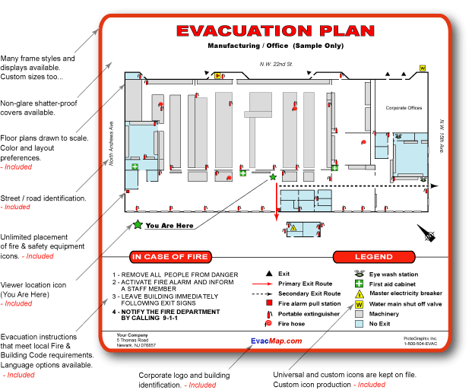
Legislation
Regulation 667 - Copies to be kept and provided
The mine operator of a mine must keep a copy of the emergency plan at the mine.
The mine operator must ensure that a copy of the emergency plan is available on request to any emergency service organisation consulted with under Regulation 665.

Slide 21
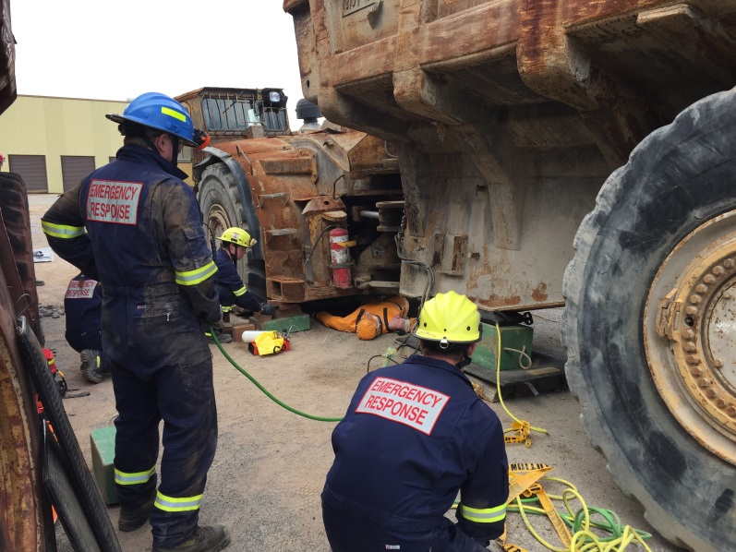
Legislation
Regulation 668 - Resources for emergency plan
The mine operator of a mine must ensure that:
all resources, including rescue equipment, specified in the emergency plan for the mine are provided in accordance with the plan; and
all equipment, including rescue equipment, specified in the emergency plan is maintained in good working order.

Slide 22
Legislation
Regulation 669 - Testing of emergency plan
The mine operator must test the emergency plan at least once a year having regard to the recommendations made by the emergency service organisations consulted under Regulation 665 in preparing the plan.
In addition, where the mine is a determined major hazard facility, the mine operator must test the emergency plan in accordance with the recommendations made by the emergency service organisations referred to in Regulation 665(1) before applying for a licence for the major hazard facility.
Note: More frequent testing may be required.

Slide 23
Legislation
Regulation 670 - Review
If a risk control measure is revised under Regulation 38 or Regulation 618, the mine operator of the mine must ensure that the emergency plan is:
reviewed and as necessary revised in relation to all aspects of risk control addressed by the revised control measure.
In addition, where the mine is a determined major hazard facility, the mine operator for the mine must:
review and as necessary revise the emergency plan if a circumstance referred to in Regulation 559(2) exists.
In reviewing and revising the emergency plan for the purposes of subregulation (2), the operator must:
consult with the emergency service organisations referred to in Regulation 665.

Slide 24
Legislation
Underground mines
Regulation 671 - Emergency exits
The mine operator of an underground mine must ensure that the mine has at least 2 trafficable exits to the surface.
The mine operator of a mine must ensure that the mine has at least 1 trafficable exit to the surface which:
is accessible from each level in the mine in which stoping operations are being carried out; and
allows for the passage of rescue persons and rescue equipment; and
is marked or signposted so that it can be readily located in an emergency; and
is maintained so that it remains effective.

Slide 25
Legislation
Emergency exits continued
The exits are located so as to ensure that an incident or event that occurs that prevents 1 exit from being used for the purpose of escape, does not prevent persons from using the other exit to escape.
The mine operator of a mine is not required to comply with Regulation 671 subregulation (1) (have at least 2 trafficable exits to the surface) in either of the following circumstances:
a single entry drive or shaft is being developed; or
the most distant area of the mine is no more than 250 metres from the mine entrance.
As long as the mine operator ensures that at least 1 exit compiles with Regulation 671 subregulation (2).

Slide 26
Legislation
Regulation 672 - Safe escape and refuge
The mine operator of an underground mine must provide adequate means of communicating with all affected persons when the emergency plan for the mine is implemented.
Example: An alarm system.
The mine operator of an underground mine must provide adequate means of escape that enable persons to safely reach an exit or refuge, including through conditions of reduced visibility or irrespirable or unsafe atmospheres.

Slide 27
Legislation
Regulation 673 - Signage for refuges
The mine operator of an underground mine that includes a refuge must ensure that signs are prominently displayed at the mine showing the location of each refuge.
Regulation 674 - Self-rescuers
The mine operator of an underground mine must ensure that a person who is to go underground is provided with an appropriate self-contained self-rescuer if there is a risk of an irrespirable atmosphere in the underground mine (including during an emergency).
The mine operator must ensure that the person is trained in the use of, and is able to use, the self-rescuer provided.

Slide 28
Legislation
Regulation 675 - Personal protective equipment in emergencies
This regulation applies in relation to a worker who is to enter an underground mine in an emergency in order to carry out first aid or rescue procedures.
The mine operator of the underground mine must ensure that oxygen or air supplied respiratory equipment is available for use by, and is provided to, the worker in an emergency in which:
the concentration of oxygen falls below a safe oxygen level; or
the atmosphere in the underground mine has a harmful concentration of an airborne contaminant; or
there is a serious risk of the atmosphere in the underground mine becoming affected in the way referred to in paragraph (a) or (b) while the worker is in the underground mine.

Slide 29
Legislation
Personal protective equipment in emergencies continued
The mine operator must ensure that suitable personal protective equipment is available for use by, and is provided to the worker in an emergency in which:
there has been an inundation or inrush of any substance in the underground mine; or
there is a serious risk of an inundation or inrush of any substance occurring while the worker is in the underground mine.
The mine operator must ensure, so far as is reasonably practicable, that a worker uses the personal protective equipment provided.

Slide 30
Further Assistance
MAQOHSC Work Health and Safety Specialists are available to provide further on-site support and assistance on all Work Health and Safety matters.
MAQOHSC Work Health and Safety Specialists can be contacted via our online support request form available on our website at www.maqohsc.sa.gov.au or email maqohsc@sa.gov.au.
Work Health and Safety Legislation, Codes of Practice, fact sheets, Health and Safety Representatives (HSR) information and guides can be found at the following websites:
SafeWork SA – www.safework.sa.gov.au or call 1300 365 255
Safe Work Australia – www.safeworkaustralia.gov.au or call 1300 551 832

