Slide 1
Work Health and Safety
Obligations and Due Diligence
April 2017

Slide 2
The Mining and Quarrying Occupational Health and Safety Committee
Promoting Work Health and Safety in the Workplace
This workplace industry safety presentation is developed and fully funded by the Mining and Quarrying Occupational Health and Safety Committee (MAQOHSC).
ISBN 978-1-925361-34-6

Slide 3
Disclaimer
IMPORTANT: The information in this presentation is of a general nature, and should not be relied upon as individual professional advice. If necessary, legal advice should be obtained from a legal practitioner with expertise in the field of Work Health and Safety law (SA).
Although every effort has been made to ensure that the information in this presentation is complete, current and accurate, the Mining and Quarrying Occupational Health and Safety Committee, any agent, author, contributor or the South Australian Government, does not guarantee that it is so, and the Committee accepts no responsibility for any loss, damage or personal injury that may result from the use of any material which is not complete, current and accurate.
Users should always verify historical material by making and relying upon their own separate inquiries prior to making any important decisions or taking any action on the basis of this information.

Slide 4
Creative Commons
This creative commons licence allows you to copy, communicate and or adapt our work for non-commercial purposes only, as long as you attribute the work to Mining and Quarrying Occupational Health and Safety Committee and abide by all the other licence terms therein.

Slide 5
Introduction
This presentation provides an overview of the obligations of an officer and person conducing a business or undertaking (PCBU) under the Work Health and Safety Act 2012 (SA).
It is designed to help you understand your Health and Safety obligations in the workplace.

Slide 6
Work Health and Safety Act 2012 (SA) Outline
The Work Health and Safety Act 2012 (SA) (the Act) has been developed under the Inter-Governmental Agreement (IGA) for Regulatory and Operational Reform in Occupational Health and Safety to underpin the harmonised Work Health and Safety Framework in Australia.
The harmonisation of Work Health and Safety laws is part of the Council of Australian Governments’ National Reform Agenda aiming to reduce regulatory burdens and create a seamless national economy.
The objects of harmonising Work Health and Safety laws through a model framework are:
to protect the health and safety of workers
to improve safety outcomes in workplaces
to reduce compliance costs for business
to improve efficiency for regulator agencies.

Slide 7
Work Health and Safety Act 2012 (SA) Outline continued
The Act includes the following key elements:
a primary duty of care requiring PCBUs to, so far as is reasonably practicable, ensure the health and safety of workers and others who may be affected by the carrying out of work
duties of care for persons who influence the way work is carried out, as well as the integrity of products used for work
a requirement that ‘officers’ exercise ‘due diligence’ to ensure compliance
reporting requirements for ‘notifiable incidents’ such as the serious illness, injury or death of persons and dangerous incidents arising out of the conduct of a business or undertaking
a framework to establish a general scheme for authorisations, such as licences, permits and registrations (e.g. for persons engaged in high risk work or users of certain plant or substances)

Slide 8
Work Health and Safety Act 2012 (SA) Outline continued
provision for consultation on work health and safety matters, participation and representation provisions
provision for the resolution of work health and safety issues
protection against discrimination for those who exercise or perform or seek to exercise or perform powers, functions or rights under the Act
an entry permit scheme that allows authorised permit holders to: inquire into suspected contraventions of work health and safety laws affecting workers who are members, or eligible to be members of the relevant union and whose interests the union is entitled to represent, and consult and advise such workers about work health and safety matters.
provision for enforcement and compliance including a compliance role for work health and safety inspectors
regulation-making powers and administrative processes including mechanisms for improving cross-jurisdictional cooperation.

Slide 9
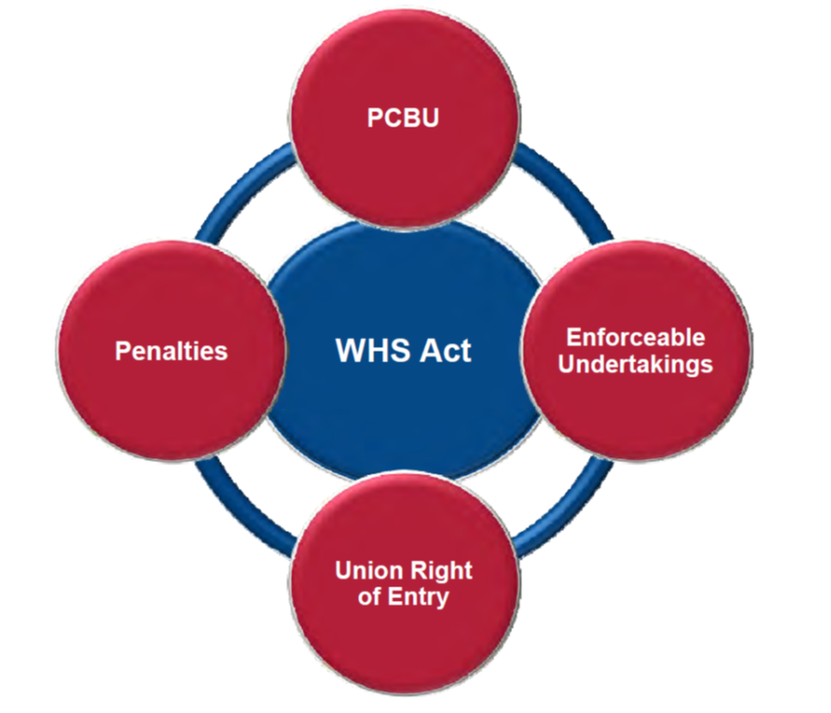
Key Changes
Notes:
Employer is now a PCBU “Person Conducting a Business or Undertaking”
Enforceable Undertaking – replaces improvement notices
Union Right of entry – Union officials may enter workplaces for WHS purposes, strict guidelines for entry are in place.
Now an emphasis on graduated enforcement and higher penalties, previously six divisions of fines, has changed to 3 Categories.
Cat 3 – Corporations $500,000, Officers $100,000, Worker $50,000
Cat 2 - Corporations $1.5m, Officers $300,000, Worker $150,000
Cat 1 - Corporations $3m, Officers $600,000 / 5 years jail, Worker $300,000 / 5 years jail
Categories are based on degree of ‘culpability’ and risk / degree of harm

Slide 10
Key Elements of Work Health and Safety Act 2012 (SA)
Work Health and Safety Act 2012 (SA) is mostly consistent with South Australian Occupational Health Safety and Welfare Act 2010 (SA)
Same tests apply re: “reasonably practicable”
Positive duty attributed to Officers with Due Diligence defined
A person can have more than one duty or can have concurrent duties
Emphasis on graduated enforcement and higher penalties
Broadened consultation obligations – vertical and horizontal
Cannot ‘contract out’ duties
Work Health and Safety Act and Regulations supported by:
  approved codes of practice (evidentiary status)
  guidance material (represents best practice)

Slide 11
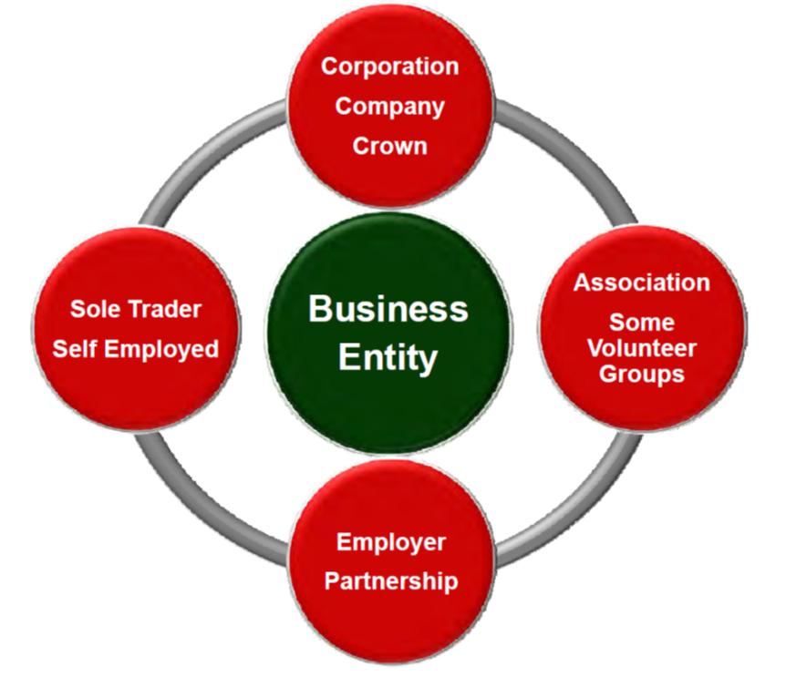
The PCBU
Notes:
WHS Act 2012 SA
Subdivision 2—Other important terms
5—Meaning of person conducting a business or undertaking
For the purposes of this Act, a person conducts a business or undertaking—
whether the person conducts the business or undertaking alone or with others; and
whether or not the business or undertaking is conducted for profit or gain.
A business or undertaking conducted by a person includes a business or undertaking conducted by a partnership or an unincorporated association.
If a business or undertaking is conducted by a partnership (other than an incorporated partnership), a reference in this Act to a person conducting the business or undertaking is to be read as a reference to each partner in the partnership.
A person does not conduct a business or undertaking to the extent that the person is engaged solely as a worker in, or as an officer of, that business or undertaking.
An elected member of a local authority does not in that capacity conduct a business or undertaking.
The regulations may specify the circumstances in which a person may be taken not to be a person who conducts a business or undertaking for the purposes of this Act or any provision of this Act.
A volunteer association does not conduct a business or undertaking for the purposes of this Act.
In this section—
volunteer association means a group of volunteers working together for one or more community purposes where none of the volunteers, whether alone or jointly with any other volunteers, employs any person to carry out work for the volunteer association.

Slide 12
Obligations of a PCBU
Primary duty of care – quantified by ‘reasonably practicable’
Primary duty is to ensure so far as is ‘reasonably practicable’ the duty to:
  provide a safe working environment
  provide safe plant and structures
  provide safe systems of work
  ensure the safe use, handling, and storage of plant, structure and substances
  provide adequate facilities to support the welfare of workers
  provide information, training, instruction or supervision
  monitor the health of workers and conditions at the workplace.
Must be proactive in fulfilling the primary duty and cannot assume another has taken care of a work health and safety matter.

Slide 13
Obligations of a PCBU - Consultation
Must consult so far as reasonably practicable with workers who carry out work for the business or undertaking or who are likely to be directly affected by a work health and safety matter… regardless if they are directly employed
Consultation must be proactive
Consultation should be proportionate to the circumstances having a regard for:
  size and structure of the business
  nature of the work
  urgency of the issue
  nature / severity of the hazard / risk
  work arrangement
  characteristics of workers
Must consult, cooperate and coordinate with other duty holders that have a duty over the same matter.

Slide 14
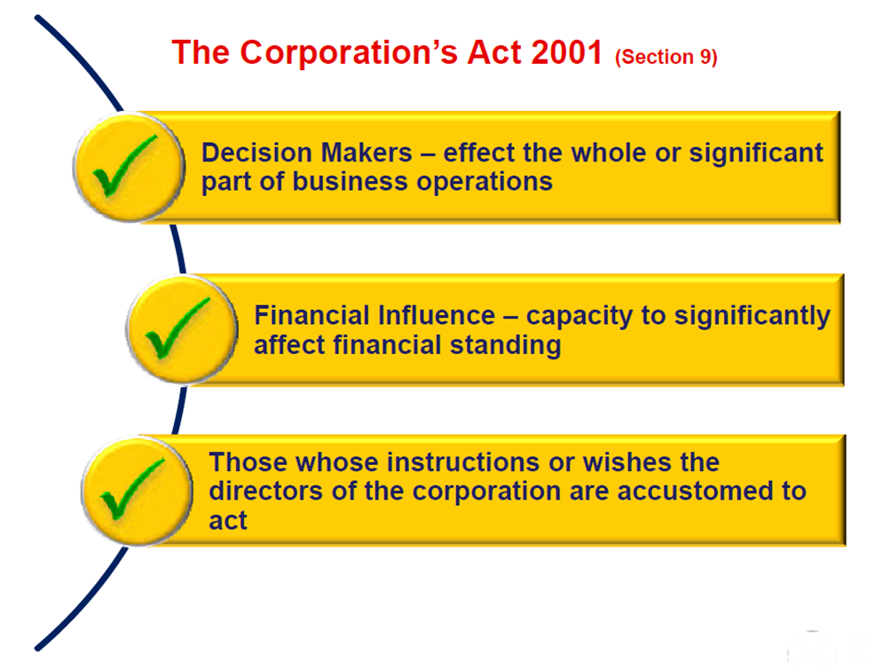
Determining an Officer
Notes:
Section 4 of the model WHS Act adopts as the definition of an officer for a corporation, partnership (with a variation noted below) or unincorporated association, the definition of that term in Section 9 of the Commonwealth Corporations Act 2001.
Under section 9 of the Corporations Act 2001 an “officer” of a corporation means:
a director or secretary of the corporation; or
a person:
who makes, or participates in making decisions that affect the whole or a substantial part, of the business of the corporation; or
who has the capacity to affect significantly the corporation’s financial standing;
in accordance with whose instructions or wishes the directors of the corporation are accustomed to act (excluding advice given by the person in the proper performance of functions attaching to the persons professional capacity or their business relationship with the directors or the corporation); or
a receiver, or receiver and manager, of the property of the corporation; or
an administrator of the corporation; or
an administrator of a deed of company arrangement executed by the corporation; or
a liquidator of the corporation.
The Corporations Act definition provides similar categories for an officer of a partnership or an unincorporated association.

Slide 15
What is meant by ‘Participate in Making Decisions’?
A person may be an officer even though they do not make the relevant decisions or have the authority to do so, if they participate in the making of those decisions. What this means is that the person is actively involved in the process through which the decisions are made and occupies a role that may directly contribute to, promote or affect the decisions.
A person may be considered to participate in the making of decisions where they have an ongoing or repeated involvement in the process through which decisions are made.
The decisions need not be directly related to work health and safety. Decisions may affect work health and safety indirectly. How an organisation is structured, what areas of business it is involved in, and what resources are allocated to particular parts of a business may all affect how work health and safety is managed.

Slide 16
What must an Officer do?
The health and safety duty of an officer requires them to exercise due diligence to ensure compliance by the PCBU with its health and safety obligations.
An officer must ensure that the PCBU has in place appropriate systems of work and must actively monitor and evaluate health and safety management. An officer’s duty is aimed at achieving and sustaining compliance by the PCBU, which may not occur without the active involvement of its officers.

Slide 17
Examples of duties or obligations
Examples of a PCBU’s duties or obligations which are specified in section 27(5)(e) of the Work Health and Safety Act 2012 (SA) for paragraph 5 above are:
reporting notifiable incidents
consulting with workers
ensuring compliance with notices issued under the Work Health and Safety Act 2012 (SA)
ensuring the provision of training and instruction to workers about work health and safety
ensuring that health and safety representatives receive their entitlements to training.
Notes:
This list is not meant to be exhaustive. There may be other things required for an officer to show that they have exercised due diligence in the particular circumstances. For example, an officer could not be said to be exercising due diligence to ensure compliance by the PCBU with its duties under the WHS Act, if the officer did not take action to ensure that significant issues with the health and safety performance of a contractor, of which they were aware, were properly addressed.

Slide 18
What is meant by ‘Reasonable Steps’
Officers will only be required to take reasonable steps to ensure that they have the relevant knowledge and understanding or take the relevant decision or action. What is reasonable will depend on the particular circumstances, including the role and influence able to be exercised by the individual officer.
Officers may meet the due diligence requirements in some respects by proper reliance on information from and the activities of others, while having more direct involvement in health and safety management and governance in other aspects.
To the extent to which an officer will seek to rely on others, the officer must be able to demonstrate the reasonableness of that reliance, which may be demonstrated through the receipt of credible information and advice from appropriate people.

Slide 19
What is ‘Due Diligence’?
Due diligence is defined in the Work Health and Safety Act 2012 (SA). In demonstrating due diligence, officers will need to show that they have taken reasonable steps to:
acquire and update their knowledge of work health and safety matters
understand the operations being carried out by the PCBU in which they are employed, and the hazards and risks associated with the operations
ensure that the PCBU has, and uses, appropriate resources and processes to eliminate or minimise health and safety risks arising from work being done
ensure that the PCBU has appropriate processes in place to receive and respond promptly to information regarding incidents, hazards and risks
ensure that the PCBU has, and uses, processes for complying with duties or obligations under the Act.
This approach emphasises the corporate governance responsibilities of officers. It is critical to the achievement of positive safety outcomes for senior management to lead the corporate safety agenda.

Slide 20
Demonstrating Due Diligence
Suggestions on how to meet the due diligence requirements are set out below.
Acquiring knowledge of health and safety issues
This can be met by:
acquiring up-to-date knowledge of the Work Health and safety Act 2012 (SA), the Work Health and Safety Regulations 2012 (SA) and approved codes of practice
investigating current industry issues through conferences, seminars information and awareness sessions
industry groups, newsletters
acquiring up-to-date knowledge of work health and safety management principles and practices
ensuring that work health and safety matters are considered at each corporation, club or association board meeting.

Slide 21
Demonstrating Due Diligence
Understanding operations and associated hazards and risks
This can be met by:
developing a plan of the operation that identifies hazards in core activities
ensuring that information is readily available to other officers and workers about procedures to ensure the safety of specific operations that pose health and safety risks in the workplace
continuously improving the safety management system.

Slide 22
Demonstrating Due Diligence
Ensuring that appropriate resources and processes are used to eliminate or minimise risks to health and safety
This can be met by:
establishing / maintaining safe methods of work
implementing a safety management system
recruiting personnel with appropriate skills, including safety personnel
ensuring staffing levels are adequate for safety in operations
giving safety personnel access to decision makers for urgent issues
maintaining / upgrading infrastructure.

Slide 23
Demonstrating Due Diligence
Implementing processes for receiving and considering information about incidents, hazards and risks
This can be met by:
employing a risk management process
having efficient, timely reporting systems
empowering workers to cease unsafe work and request better resources
establishing processes for considering and responding to information about incidents, hazards and risks in a timely fashion
measuring against positive performance indicators to identify deficiencies (e.g. percentage of issues actioned within agreed timeframe).

Slide 24
Demonstrating Due Diligence
Establishing and maintaining compliance processes
This can be met by:
undertaking a legal compliance audit of policies, procedures and practices
testing policies, procedures and practices to verify compliance with safety management planning.
ACCESSING UP TO DATE SAFETY INFORMATION
As part of due diligence requirements, officers need up to date knowledge about safety issues. They must also ensure that their employer and workers have ready access to information that will help them to avoid risks and hazards in the workplace.

Slide 25
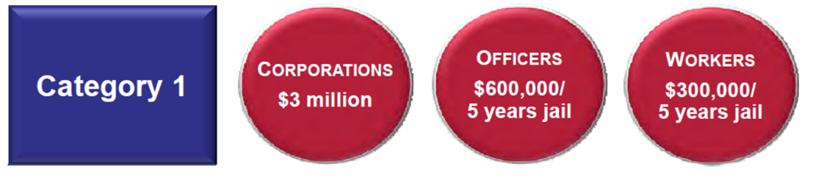
Penalties
Categories based on degree of culpability and risk / degree of harm
Section 31 - Reckless conduct - Category 1
A person commits a Category 1 offence if -
  the person has a health and safety duty
  the person, without reasonable excuse, engages in conduct that exposes an individual to whom that duty is owed to a risk of death or serious injury or illness
  the person is reckless as to the risk to an individual of death or serious injury or illness.
Notes:
Maximum penalty:
in the case of an offence committed by an individual (other than as a person conducting a business or undertaking or as an officer of a person conducting a business or undertaking)—$300 000 or 5 years imprisonment or both;
in the case of an offence committed by an individual as a person conducting a business or undertaking or as an officer of a person conducting a business or undertaking—$600 000 or 5 years imprisonment or both;
in the case of an offence committed by a body corporate—$3 000 000.
The prosecution bears the burden of proving that the conduct was engaged in without reasonable excuse.

Slide 26
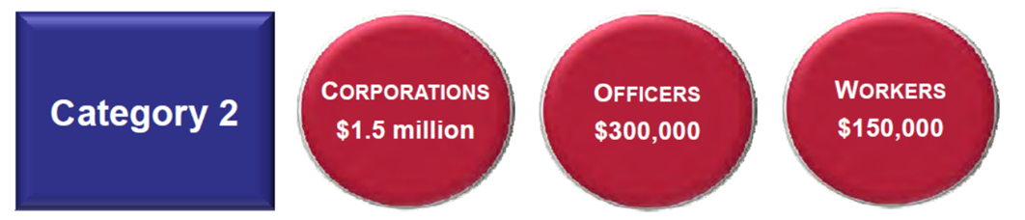
Penalties
Section 32 - Failure to comply with health and safety duty - Category 2
A person commits a Category 2 offence if -
  the person has a health and safety duty
  the person fails to comply with that duty
  the failure exposes an individual to a risk of death or serious injury or illness.
Notes:
Maximum penalty:
in the case of an offence committed by an individual (other than as a person conducting a business or undertaking or as an officer of a person conducting a business or undertaking)—$150 000;
in the case of an offence committed by an individual as a person conducting a business or undertaking or as an officer of a person conducting a business or undertaking—$300 000;
in the case of an offence committed by a body corporate—$1 500 000.

Slide 27
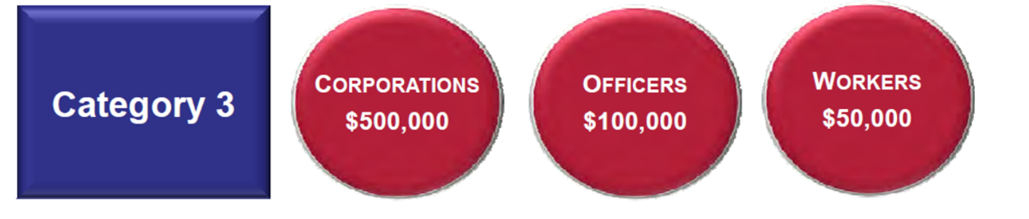
Penalties
Section 33 - Failure to comply with health and safety duty - Category 3
A person commits a Category 3 offence if -
  the person has a health and safety duty
  the person fails to comply with that duty.
Notes:
Maximum penalty:
in the case of an offence committed by an individual (other than as a person conducting a business or undertaking or as an officer of a person conducting a business or undertaking)—$50 000;
in the case of an offence committed by an individual as a person conducting a business or undertaking or as an officer of a person conducting a business or undertaking—$100 000;
in the case of an offence committed by a body corporate—$500 000.

Slide 28
Personal Liability
How do the provisions affect personal liability?
As a criminal penalty, the personal penalty is not covered by directors and officers insurance policy.
The company may not be able to indemnify directors and managers in relation to the penalty and/or legal costs.

Slide 29
Further Assistance
MAQOHSC Work Health and Safety Specialists are available to provide further on-site support and assistance on all Work Health and Safety matters.
MAQOHSC Work Health and Safety Specialists can be contacted via our online support request form available on our website at www.maqohsc.sa.gov.au or email maqohsc@sa.gov.au.
Work Health and Safety Legislation, Codes of Practice, fact sheets, Health and Safety Representatives (HSR) information and guides can be found at the following websites:
SafeWork SA – www.safework.sa.gov.au or call 1300 365 255
Safe Work Australia – www.safeworkaustralia.gov.au or call 1300 551 832

