Slide 1
Hazardous Manual Tasks and Prevention
of Musculoskeletal Disorders (MSD)
April 2017

Slide 2
The Mining and Quarrying Occupational Health and Safety Committee
Promoting Work Health and Safety in the Workplace
This workplace industry safety presentation is developed and fully funded by the Mining and Quarrying Occupational Health and Safety Committee (MAQOHSC).
ISBN 978-1-925361-40-7

Slide 3
Disclaimer
IMPORTANT: The information in this presentation is of a general nature, and should not be relied upon as individual professional advice. If necessary, legal advice should be obtained from a legal practitioner with expertise in the field of Work Health and Safety law (SA).
Although every effort has been made to ensure that the information in this presentation is complete, current and accurate, the Mining and Quarrying Occupational Health and Safety Committee, any agent, author, contributor or the South Australian Government, does not guarantee that it is so, and the Committee accepts no responsibility for any loss, damage or personal injury that may result from the use of any material which is not complete, current and accurate.
Users should always verify historical material by making and relying upon their own separate inquiries prior to making any important decisions or taking any action on the basis of this information.

Slide 4
Creative Commons
This creative commons licence allows you to copy, communicate and or adapt our work for non-commercial purposes only, as long as you attribute the work to Mining and Quarrying Occupational Health and Safety Committee and abide by all the other licence terms therein.

Slide 5
Session overview
What are hazardous manual tasks?
Legislative requirements
Industry statistics
What is a musculoskeletal disorder (MSD)?
Anatomy of the spine
How do musculoskeletal disorders occur?
How can we prevent these injuries?
When should a risk assessment be conducted?
Assessing risks for hazardous manual tasks.

Slide 6
What are Hazardous Manual Tasks?
A Hazardous Manual Task is anything that requires a
person to do the following:
Lift
Lower
Push
Pull
Carry or otherwise move
Hold or restrain any person animal or thing.
Notes:
This could involve one or more of the following :-
Repetitive or sustained force
High or sudden force
Repetitive movement
Sustained or awkward posture
Exposure to vibration
These factors (known as characteristics of a hazardous manual task) directly stress the body and can lead to injury

Slide 7
Legislative requirements
Work Health and Safety Act 2012 (SA)
Section 17 - Management of risks
Section 18 - What is reasonably practicable in ensuring health and safety
Section 19 - Primary duty of care
Section 20 - Duty of persons conducting businesses or undertakings (PCBU) involving management or control of workplaces
Section 28 - Duties of workers
Notes:
WHS Act—section 19 (see regulation 9).
A person conducting a business or undertaking must ensure, so far as is reasonably practicable, the health and safety of—
(a) workers engaged, or caused to be engaged by the person; and
(b) workers whose activities in carrying out work are influenced or directed by the person, while the workers are at work in the business or undertaking.
28—Duties of workers
While at work, a worker must—
(a) take reasonable care for his or her own health and safety; and
(b) take reasonable care that his or her acts or omissions do not adversely affect the health and safety of other persons; and
(c) comply, so far as the worker is reasonably able, with any reasonable instruction that is given by the person conducting the business or undertaking to allow the person to comply with this Act; and
(d) co-operate with any reasonable policy or procedure of the person conducting the business or undertaking relating to health or safety at the workplace that
has been notified to workers.

Slide 8
Legislative requirements
Work Health and Safety Regulations 2012 (SA)
Sections 34 and 38 - Managing risk under the Regulations
Section 60 - PCBU must manage risks to health and safety relating to MSD associated with a hazardous manual task
Section 61 - Duties of designers, manufacturers, importers and suppliers of plant or structures
Notes:
Work Health and Safety Regulations 2012
Chapter 3—General risk and workplace management
Part 1—Managing risks to health and safety
38-38 In order to manage risk under the WHS Regulations, a duty holder must:
Identify reasonably foreseeable hazards that could give rise to the risk
Eliminate the risk so far as is reasonably practicable
If it is not reasonably practicable to eliminate the risk – minimise the risk so far as is reasonably practicable by implementing control measures in accordance with the hierarchy of control
Maintain the implemented control measure so that it remains effective
Review, and if necessary revise, risk control measures so as to maintain, so far as is reasonably practicable, a work environment that is without risks to health and safety.
60—Managing risks to health and safety:
(1) A person conducting a business or undertaking must manage risks to health and safety relating to a musculoskeletal disorder associated with a hazardous manual task, in accordance with Chapter 3 Part 1.
Note—
(2) In determining the control measures to implement under subregulation (1), the person conducting the business or undertaking must have regard to all relevant matters that may contribute to a musculoskeletal disorder, including—
(a) postures, movements, forces and vibration relating to the hazardous manual task; and
(b) the duration and frequency of the hazardous manual task; and
(c) workplace environmental conditions that may affect the hazardous manual task or the worker performing it; and
the design of the work area; and
the layout of the workplace; and
the systems of work used; and
the nature, size, weight or number of persons, animals or things involved in carrying out the hazardous manual task.
61—Duties of designers, manufacturers, importers and suppliers of plant or structures

Slide 9
Legislative requirements
Hazardous Manual Tasks - Code of Practice
Providing guidance on how to manage the risks
Identifying manual tasks that are hazardous
If necessary, assessing the risks of MSDs associated with the hazardous manual task
Implementing suitable risk control measures
Reviewing the effectiveness of control measures.
Notes:
Hazardous Manual Tasks - Code of Practice
The Code of Practice has been developed to explain how to identify hazardous manual tasks, assess the risks of musculoskeletal disorders and eliminate or minimise those risks. This guidance is also relevant for designers, manufacturers, importers or suppliers of equipment, materials and tools used for work, as well as designers of workplaces where manual tasks are carried out.

Slide 10
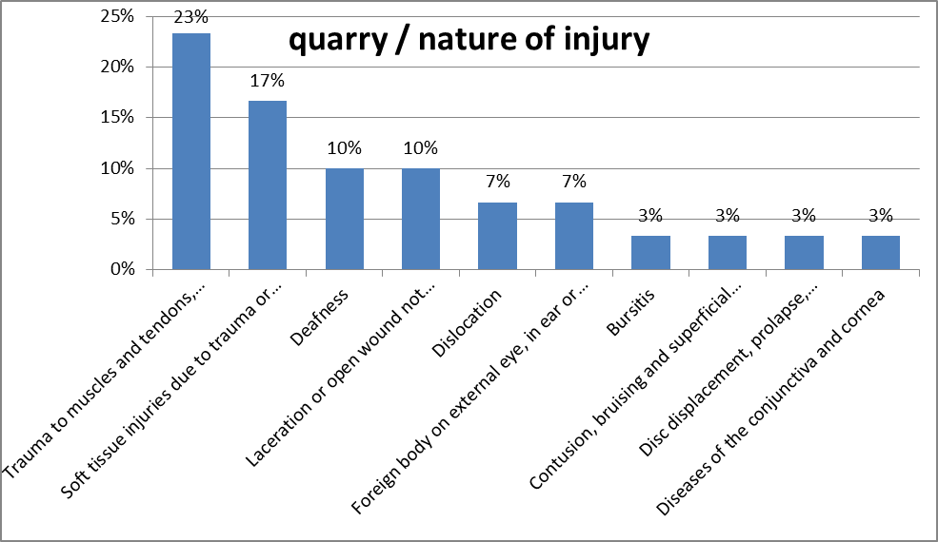
Industry Statistics
Recent provisional data – 2009-2011

Slide 11
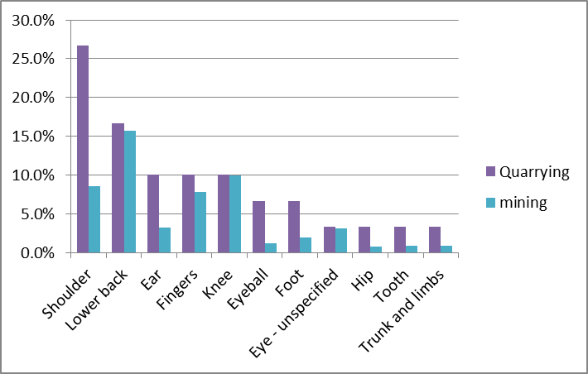
Industry Statistics
Recent industry provisional data
– 2009-2011

Slide 12
What is a
Musculoskeletal Disorder (MSD)?
A musculoskeletal disorder, as defined in the Work Health and Safety Regulations 2012 (SA):
Means an injury to, or a disease of, the musculoskeletal system
Can occur suddenly or over time (wear and tear)
Does not include an injury caused by:
  crushing, entrapment (such as fractures and dislocations)
  cutting resulting from the mechanical operation of plant.
Notes:
MSDs may include conditions such as:
Sprains and strains of muscles, ligaments and tendons
Back injuries, including damage to the muscles, tendons, ligaments, spinal discs, nerves, joints and bones
Joint and bone injuries or degeneration, including injuries to the shoulder, elbow, wrist, hip, knee, ankle, hands and feet
Nerve injuries or compression (e.g. carpal tunnel syndrome)
Muscular and vascular disorders as a result of hand-arm vibration
Soft tissue hernias, and
Chronic pain.

Slide 13
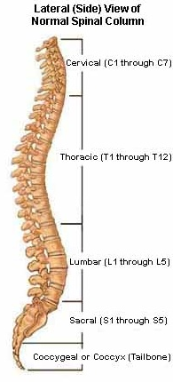
Anatomy of the spine

Slide 14
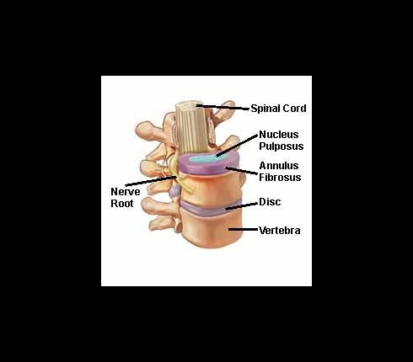
Discs – the shock absorber

Slide 15
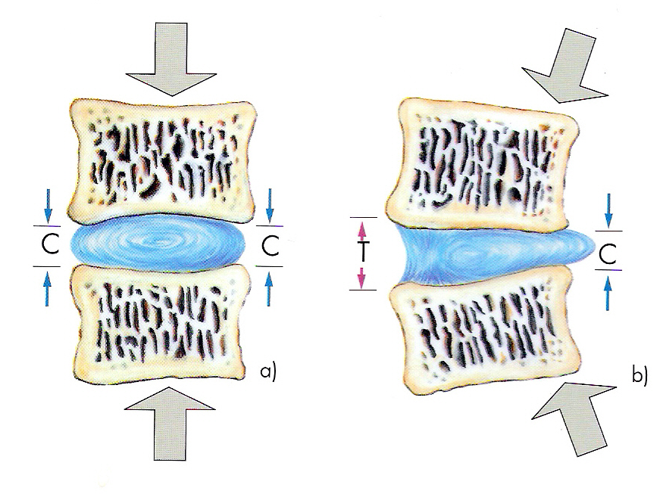
How discs work
Pressure on the invertebral discs
a) Concentric pressure produces an evenly applied compression (C) on the nucleus pulposusand the annulus fibrosus.
b) Eccentric pressure pushes the nucleus propulsus to the unaffected side; the annulus is subjected to traction forces (T).

Slide 16
How do Musculoskeletal Disorders occur?
MSDs occur in three ways:
Gradual wear and tear
Sudden damage caused by strenuous activity,
or unexpected movements
A combination of these mechanisms which may
cause an “event”.
Notes:
MSDs occur in two ways:
Gradual wear and tear to joints, ligaments, muscles and inter-vertebral discs caused by repeated or continuous use of the same body parts, including static or awkward body posture, exposure to vibration, repetitive or sustained force
High or sudden force caused by strenuous activity, or unexpected movements such as when loads being handled move or change position suddenly.
Injuries can also occur due to a combination of these mechanisms, for example, body tissue that has been weakened by cumulative damage may be vulnerable to a sudden injury.
You may have heard people refer to it as a “slipped disc” by those that have hurt their backs.
However discs don’t actually slip as can been seen in the next slide.
These factors (known as characteristics of a hazardous manual task) directly stress the body and can lead to injury.

Slide 17
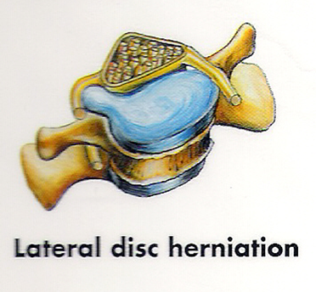
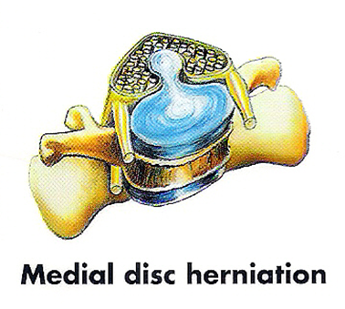
Disc Hernias
Disc herniation
Degeneration or erosion of vertebrae and vertebral discs may cause part or all of the disc to protrude into the spinal canal, thereby compressing the spinal cord or spinal nerve roots. Disturbances in sensation, pain and paralysis can result. Herniated discs often occur in the lower lumbar region, but can also be found in the cervical area.

Slide 18
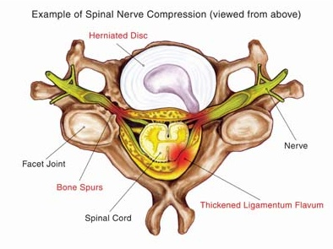
Spinal Nerve Compression

Slide 19
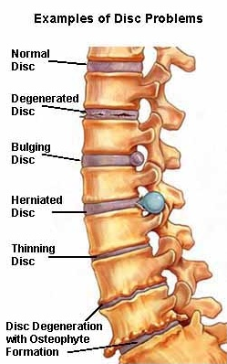
Don’t look after your back = problems

Slide 20
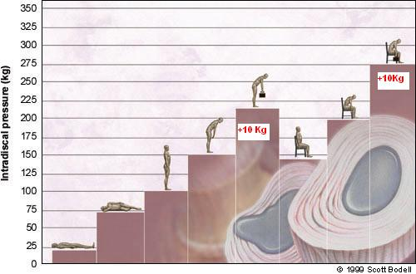
Disc pressure – your back is NOT a crane
Notes:
A study by Nachemson was conducted into the pressures exerted on the L3 disc of a 70Kg person in different postures.
It involved measuring intradiscal pressure (vertical and horizontal) using an advanced pressure sensor.
These disc pressure were measured in more than 100 individuals over a 20 years and it demonstrated how the load on the lumbar disc varies with the position of the subject's body and during the performance of various tasks, both in standing and in sitting. Compared with the pressure or load in the upright standing position, reclining reduces the pressure by 50-80%, while unsupported sitting increases the load by 40%, forward leaning and weight lifting by more than 100%, and the position of forward flexion and rotation by 400%.

Slide 21
How can we prevent these injuries?
Assess the risk
Avoid lifting whenever possible
Take time and assess the load
Is this a team lift?
Warm up before lifting
Use good lifting techniques
Stay fit and flexible with regular exercises
including walking, swimming and flexibility exercises.
– Move it or lose it!

Slide 22
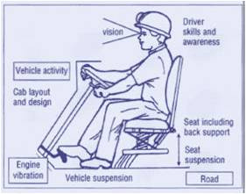
Plant seating

Slide 23
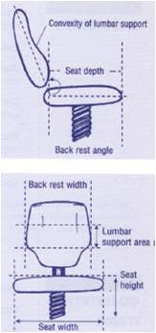
Seat Adjustments

Slide 24
When should a risk assessment be conducted?
A risk assessment should be conducted when a hazard has been identified, unless the risk is well known and you know how to control it.
A risk assessment can help determine:
Which postures, movements and forces of the task pose a risk
Where during the task they pose a risk
Why they are occurring
What needs to be fixed.

Slide 25
Assessing Risks for Hazardous
Manual Tasks
The best way to assess risks for hazardous manual tasks is to include those directly involved in the tasks.
Assessments should be conducted by at least two persons so that a balance of experience and objectivity is achieved.
Site hazardous manual task to be assessed?
So what is the risk assessment process?
Notes:
*Now you know which risk factors are present, where they are present and why they are present (sources of the risk), you are in a position to know what must be controlled and work out how to do it.

Slide 26
Assessing Risks for Hazardous
Manual Tasks
Hierarchy of control |  | Examples of control measures
Level 1 | Elimination | Automate the manual task (such as using remote controls) Deliver goods directly to the point of use to eliminate multiple handling
Level 2 | Substitution | Replace heavy items with those that are lighter, smaller and/or easier to handle Replace hand tools with power tools to reduce the level of force required to do the task
 | Isolation | Isolate vibrating machinery from the user, for example, by providing fully independent seating on mobile plant
 | Engineering | Use mechanical lifting aids Provide workstations that are height adjustable
Level 3 | Administrative | Rotate workers between different tasks Train workers to use control measures implemented when carrying out normal tasks
 | Personal protective equipment | Heat resistant gloves for handling hot items Shock absorbent shoes for work on hard concrete floors
Notes:
Now you know which risk factors are present, where they are present and why they are present (sources of the risk), you are in a position to know what must be controlled and work out how to do it.

Slide 27
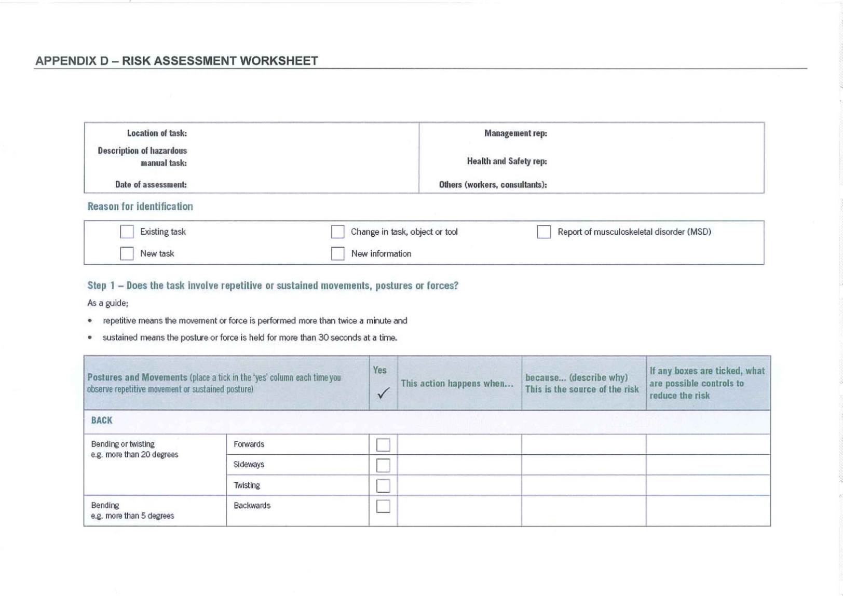
Risk Assessment Worksheet

Slide 28
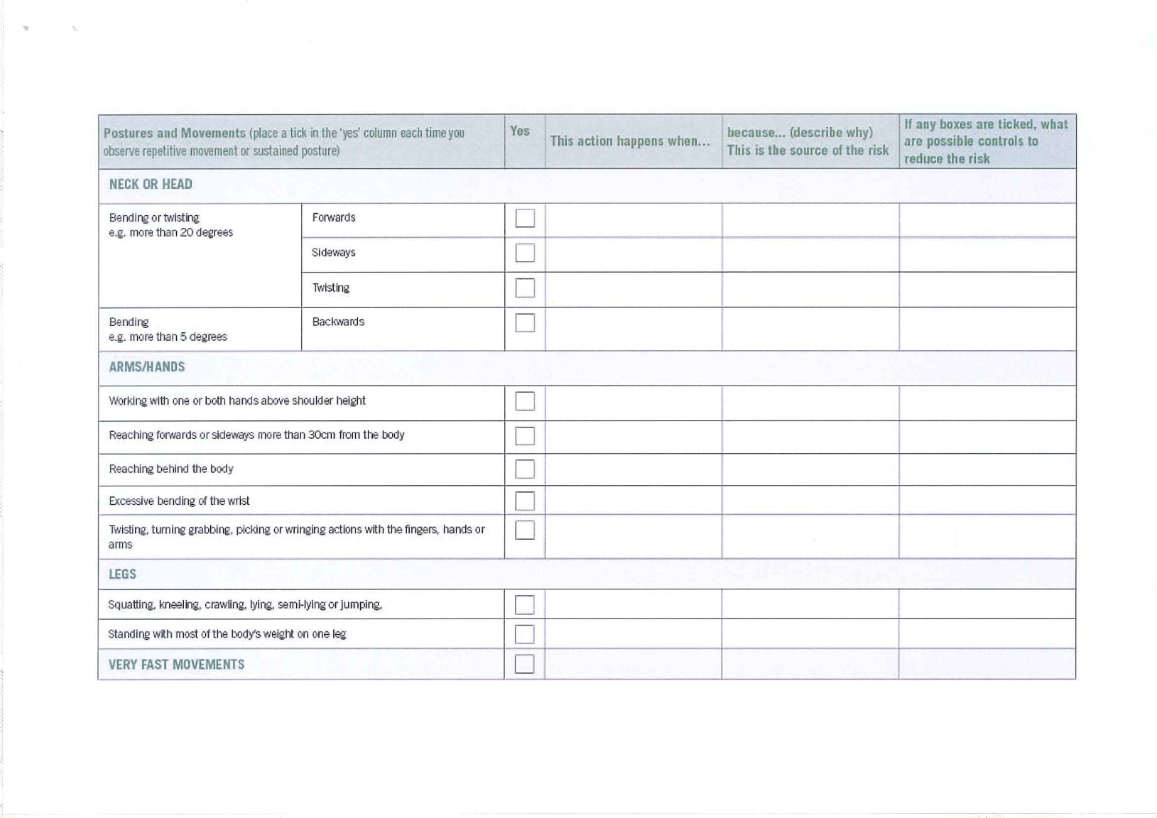
Risk Assessment Worksheet

Slide 29
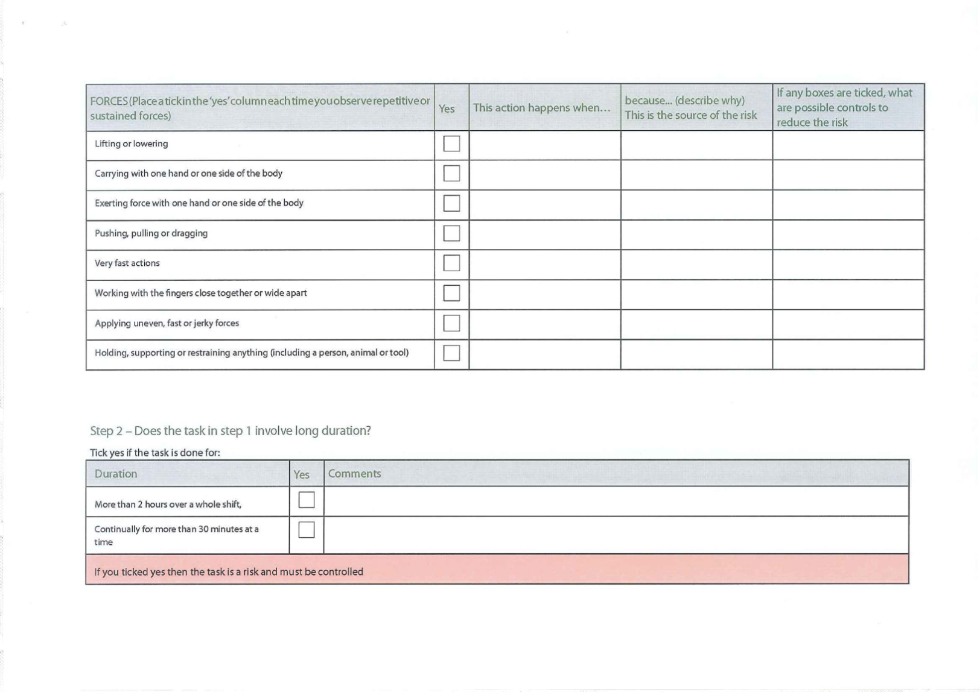
Risk Assessment Worksheet

Slide 30
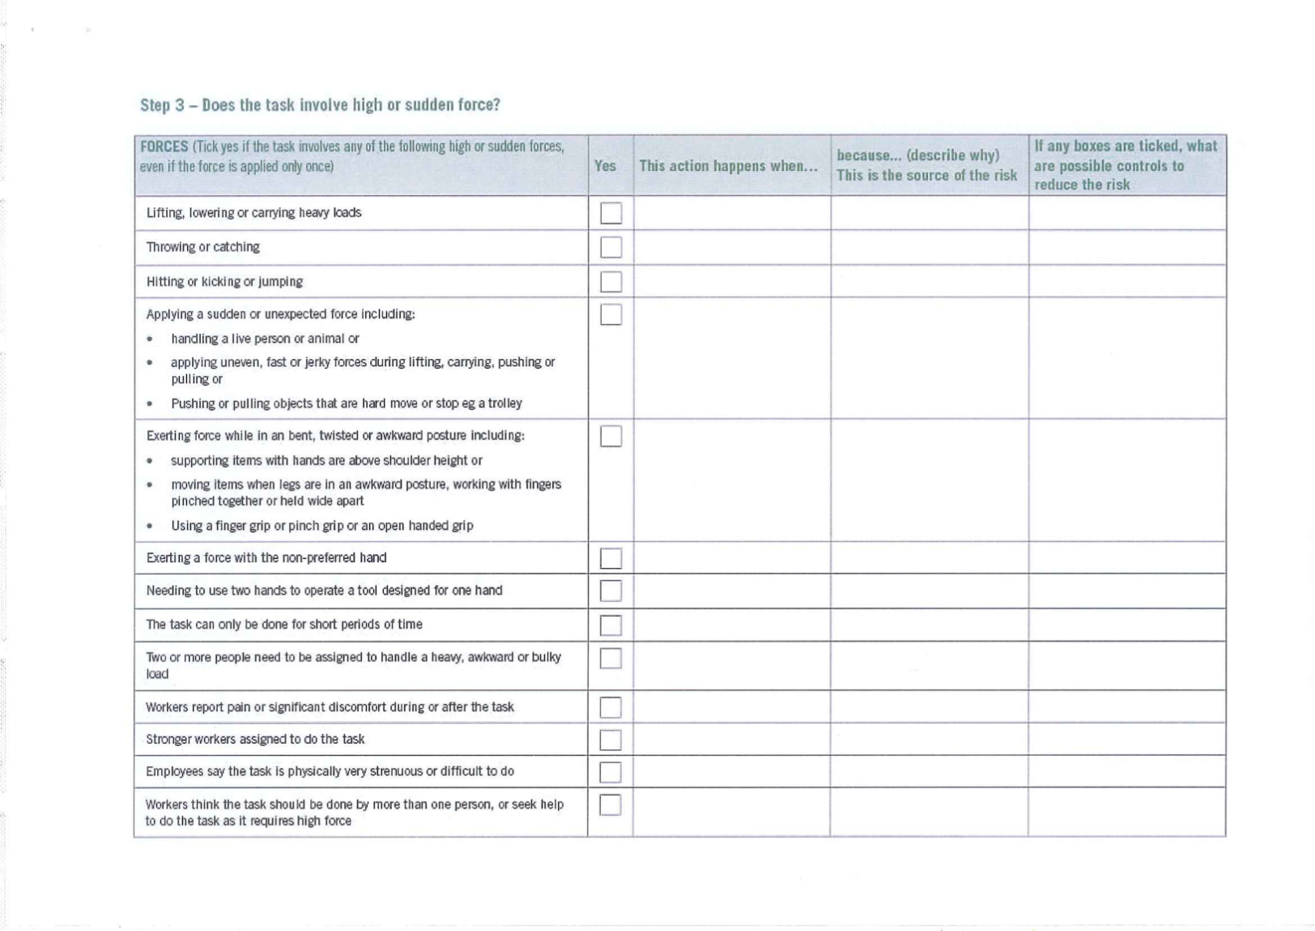
Risk Assessment Worksheet

Slide 31
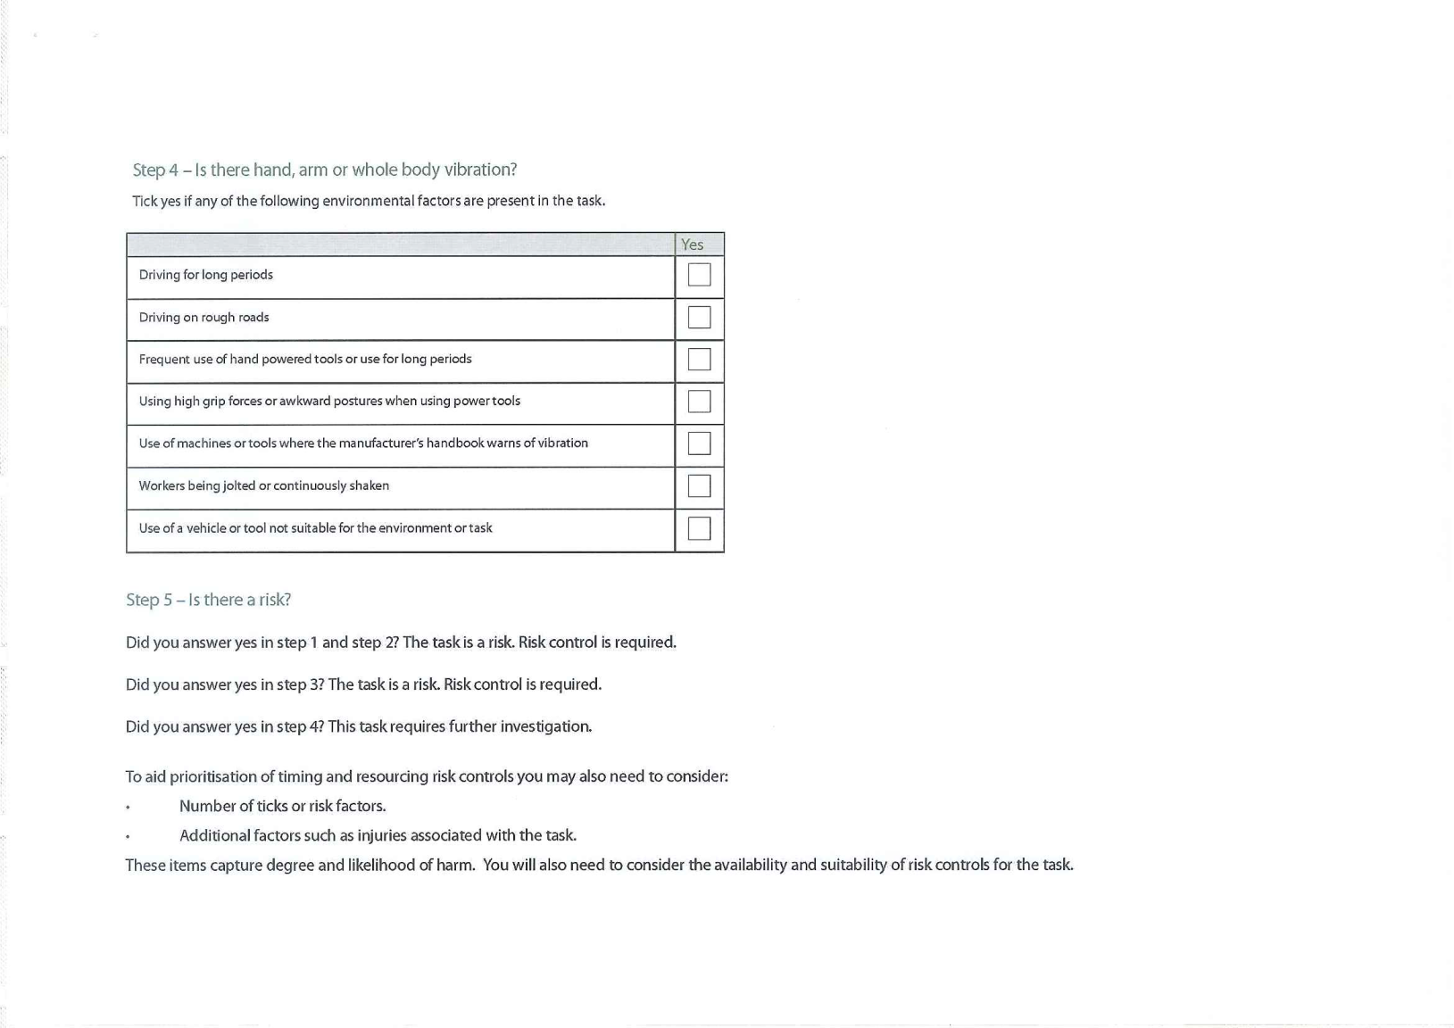
Risk Assessment Worksheet

Slide 32
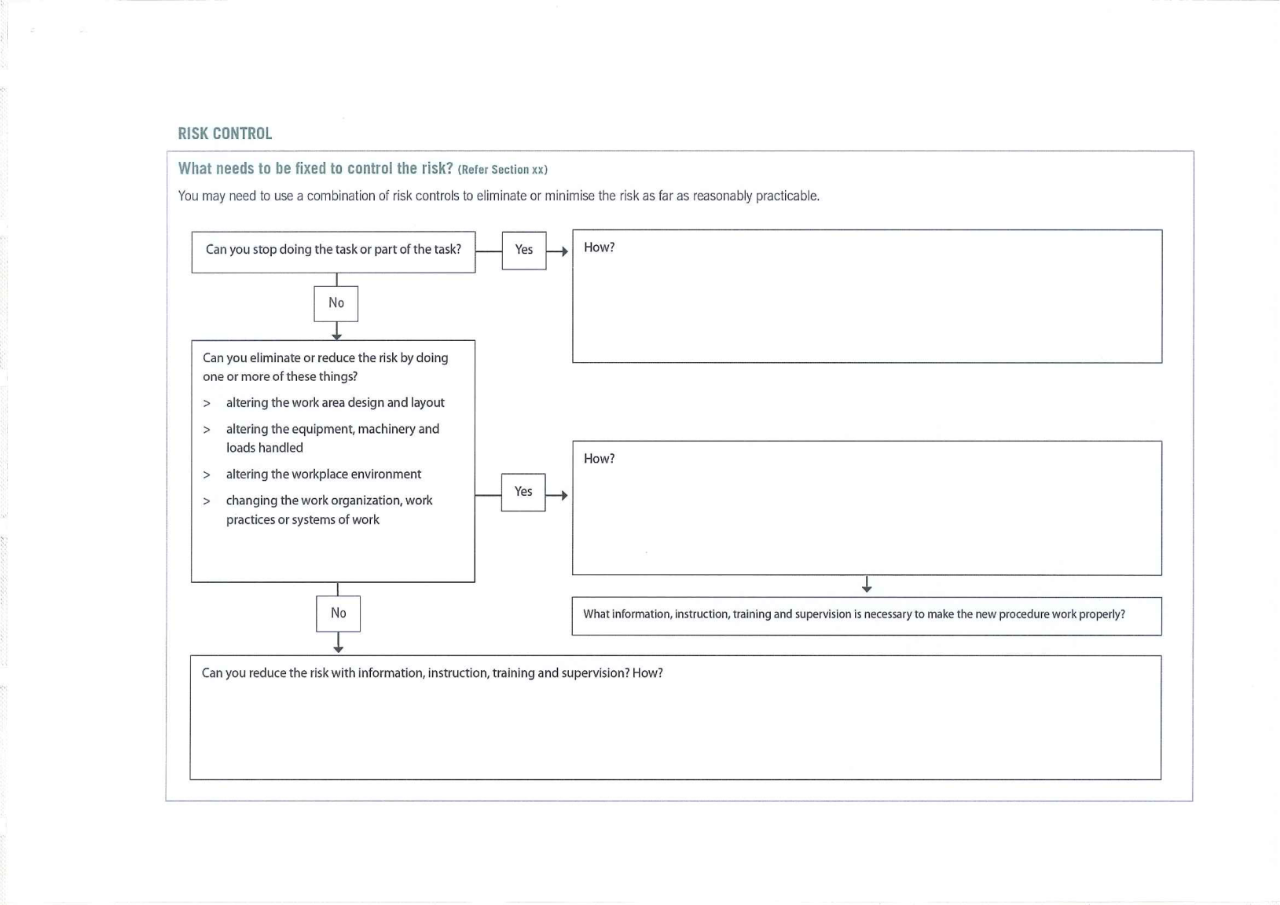
Risk Assessment Worksheet

Slide 33
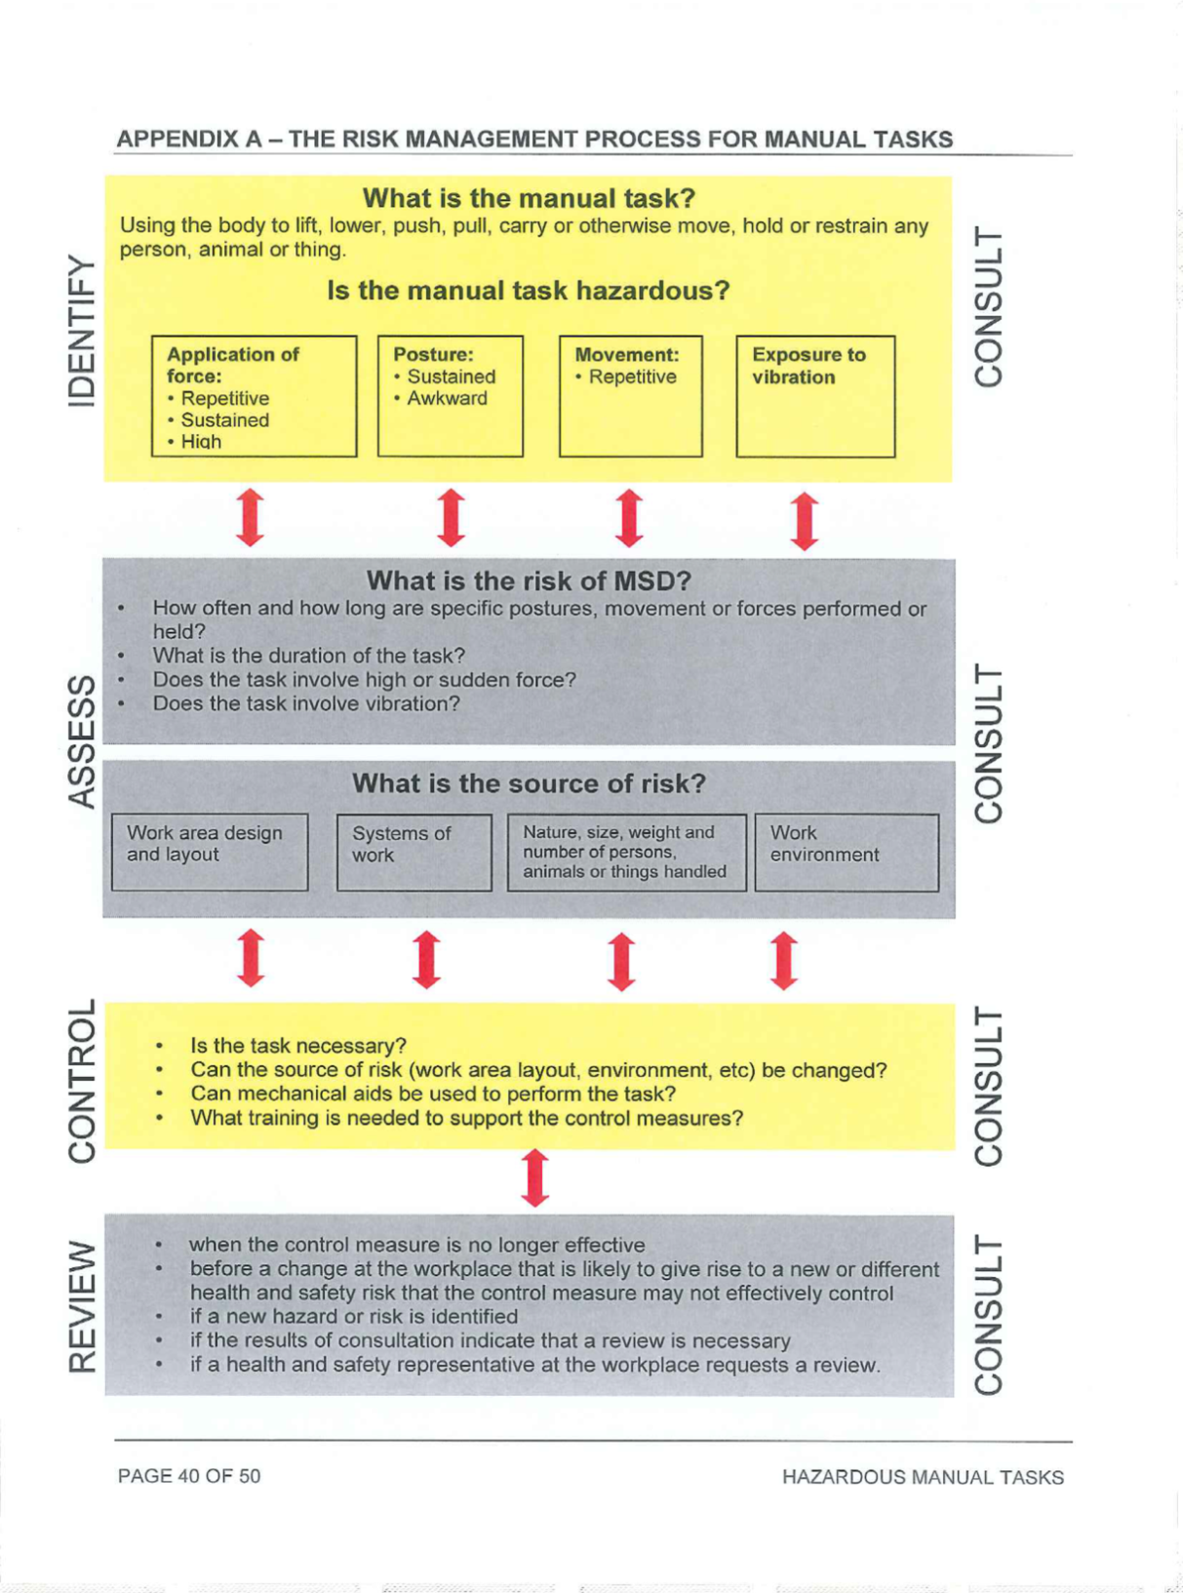

Slide 34
Further Assistance
MAQOHSC Work Health and Safety Specialists are available to provide further on-site support and assistance on all Work Health and Safety matters.
MAQOHSC Work Health and Safety Specialists can be contacted via our online support request form available on our website at www.maqohsc.sa.gov.au or email maqohsc@sa.gov.au.
Work Health and Safety Legislation, Codes of Practice, fact sheets, Health and Safety Representatives (HSR) information and guides can be found at the following websites:
SafeWork SA – www.safework.sa.gov.au or call 1300 365 255
Safe Work Australia – www.safeworkaustralia.gov.au or call 1300 551 832

