Slide 1
Incident Management,
Reporting and Investigation
April 2017

Slide 2
The Mining and Quarrying Occupational Health and Safety Committee
Promoting Work Health and Safety in the Workplace
This workplace industry safety presentation is developed and fully funded by the Mining and Quarrying Occupational Health and Safety Committee (MAQOHSC).
ISBN 978-1-925361-47-6

Slide 3
Disclaimer
IMPORTANT: The information in this presentation is of a general nature, and should not be relied upon as individual professional advice. If necessary, legal advice should be obtained from a legal practitioner with expertise in the field of Work Health and Safety law (SA).
Although every effort has been made to ensure that the information in this presentation is complete, current and accurate, the Mining and Quarrying Occupational Health and Safety Committee, any agent, author, contributor or the South Australian Government, does not guarantee that it is so, and the Committee accepts no responsibility for any loss, damage or personal injury that may result from the use of any material which is not complete, current and accurate.
Users should always verify historical material by making and relying upon their own separate inquiries prior to making any important decisions or taking any action on the basis of this information.

Slide 4
Creative Commons
This creative commons licence allows you to copy, communicate and or adapt our work for non-commercial purposes only, as long as you attribute the work to Mining and Quarrying Occupational Health and Safety Committee and abide by all the other licence terms therein.

Slide 5
Session Overview
  Definitions
  Incident Management
  Incident Investigation
  Why do we need to Manage Incidents?
  Reporting – Who is Responsible?
  Incident Investigation Process
  Summary

Slide 6
Definitions
  Corrective action
  The identification and elimination of the cause of a problem, thus preventing its reoccurrence.
  Hazard
  Something that has the potential to cause harm (injury or damage).
  Hierarchy of control
  The tool used when determining how risks are to be managed.
  Incident
  An instance of something resulting in injury or damage; an unplanned event or occurrence.

Slide 7
Definitions
  Near miss
  A near miss is an unplanned event that did not result in injury, or damage but had the potential to do so.
  Preventative action
  Actions taken to prevent the potential for similar incidents to occur.
  Risk
  The probability and consequences of the level of harm occurring.
  Root cause
  The basic cause(s) which can be reasonably identified which, when fixed, will prevent or minimise the un-wanted event from reoccurring.

Slide 8
Incident Management
Incident Management is the process of:
  controlling
  investigating
  identifying
  analysing
  rectifying
a hazard, a hazardous situation or a emergency event to prevent reoccurrence, this includes a near miss event.

Slide 9
Incident Investigation
Incident Investigation involves:
  A through and systematic approach to Identify the root cause(s) that contributed directly, or indirectly, to the incident
  Identifying any deficiencies in operational areas and the safety management system that permitted the incident to occur
  Recommendation and the implementation of specific corrective and preventative actions to prevent incident reoccurrence
  Communication of the findings and the training of workers in the revised processes and procedures
  Monitoring and reviewing control measures to ensure their effectiveness.

Slide 10
Why do we need to manage incidents?
Incidents need to be investigated and managed in order to prevent similar event from reoccurring.
Identifying how and why the incident occurred and implementing control measures to prevent it reoccurring is part of the primary duty of care for a ‘person conducting business or undertaking’ (PCBU) in relation to work health and safety in the workplace.
Whilst a PCBU should always be proactive in hazard identification and risk management, when incidents occur, it is another opportunity for the business to review and evaluate its:
  Processes and procedures
  Safety Management Systems
  Culture towards safety.
This is where the PCBU can identify deficiencies and implement controls and improvement strategies.

Slide 11
Reporting – Who is Responsible?
Within the organisation, all workers, including managers, supervisors and team leaders are responsible for reporting an incident they have been involved in or witnessed.
This relates to all incidents, including bullying, harassment or discrimination, injuries, damage, and near miss events.
If your immediate supervisor or manager is not available you should report the incident to the next senior manager or the safety officer.
If an injured person is unable to complete an incident report form, then another person can help complete it on their behalf.
A first aid attendant is also responsible for recording the treatment given to an injured worker and informing the workers’ supervisor of the first aid provided.

Slide 12
Reporting – Who is Responsible?
  Additionally, a PCBU has a duty to notify relevant authorities when certain types of incidents and injuries occur in the workplace.
  A PCBU must ensure:
  SafeWork SA is notified of fatalities, serious injuries, illnesses, and dangerous incidents as soon as the PCBU becomes aware of the incident
  SafeWork SA is notified by the fastest means available and, where the notification is by phone, this must be followed up in writing within 48 hours if SafeWork SA requests it
  If a person suffers an injury or illness where workers’ compensation is, or may be, payable then appropriate notification must be made to Return to Work SA or their agent on their behalf.
  Note:
  Where incidents are relating to electrical shock, gas infrastructure or gas fitting, the Office of the Technical Regulator (OTR) must also be notified.

Slide 13
  Incident Investigation Process
  Worker Reporting an Incident – (Initial Notification)
  Immediate Actions – (Make area Safe / Preserve the Scene)
  Planning the Investigation – (Technical support)
  Collection and Analysis of Information and Data – (Investigation method)
  Findings – (Agreed)
  Corrective and Preventative Actions
  Finalising the Incident Report
  Update Affected Procedures
  Communication of the Incident – (Safety Alert / Bulletins)
  Instruction and Training
  Inspection and Audits
  Monitor and Review for Effectiveness.

Slide 14
Worker Reporting an Incident
Where you have been involved in or witnessed an incident, it must be reported to your immediate supervision as soon as practicable.
An incident report and investigation form should be made available for the worker to complete in conjunction with their supervision stating the following:
  Incident Details
  Date, time, location of incident and the person reporting the incident
  Incident Type
  Bullying, harassment or discrimination, injuries, near miss events and damage to plant or environmental harm
  Injured Persons Details (where required)
  Name and job description

Slide 15
Worker Reporting an Incident
  Injury Details
  Type and location of injury / illness
  Medical Treatment
  First aid, ambulance, medical treatment or hospital
  (include the name of the clinic or hospital that the worker is treated at)
  Description of the Incident
  Provide a description of what happened during the incident
  Provide a description of any property damage and or environmental harm.

Slide 16
  Immediate Actions
  Where a supervisor has been made aware of an incident, they should notify key personnel (depending on the seriousness of the incident) as soon as they have been informed the event.
  Inspect and (if required) secure the site and make the area, plant or equipment safe and ensure that there are no further hazards or risk to personnel, or plant or environment.
  Where safe to do so, check for injured persons and provide first aid.
  Follow emergency procedures and contact emergency personnel where required.
  Note:
  Alcohol and drug testing (fitness for work) should be undertaken for all incidents involving road vehicles, mobile plant or where medical treatment is required; this is to establish if alcohol and drugs were a contributing factor.

Slide 17
  Immediate Actions
  Where the incident is notifiable, the person with management or control of a workplace must ensure that the site, along with any plant, substance, structure or thing where the incident occurred, is not disturbed:
  Until an inspector arrives at the site or any earlier time that the inspector directs
  Unless it is required to assist an injured person, to remove a deceased person, to make the area safe, or if directed by police.
Note:
  Secure the incident site with bunting, witches hats or guards / watchers to prevent unauthorised personnel entering the area.
  Once the scene has been secured, it is important to gather as much information about the incident while it’s fresh in the minds of personnel who witnessed the event.

Slide 18
  Planning the Investigation
  Determine the type and level of investigation and identify and nominate the ‘investigation leader’ and team members and allocate roles / tasks.
  The team should consist of a senior manager / Work Health and Safety personnel, area supervisor, and health and safety representative (HSR) (if they wish to do so).
  Generate an investigation tool kit containing:
  Pens
  Note books
  Camera
  Dictaphone
  Tape measure etc.
  Develop investigation plan and identify information to be collected.

Slide 19
  Areas to Consider
  The ‘investigation leader’ is accountable for ensuring the investigation objectives are met.
  The objective of incident investigations is to determine the cause(s) of the event and identify controls to prevent a recurrence; it is not a blame game but a fact finding process!
  The investigation should aim to determine the following:
  Where did the incident occur?
  Who or what was involved in the incident?
  Why did the incident occur?
  How did the incident occur?
  Preventative strategies.

Slide 20
  Collection of Information and Data
  Incident investigations should commence immediately and include the following:
  Quarantining of plant and equipment for purposes of review and inspection
  Photographs of the scene, including position and condition of all plant, equipment and environment associated with the incident
  Position of safety switches, controls, valves, tools, etc.
  Lighting, visibility, noise and weather
  Measurements of relevant equipment, markings, tracks, etc.
  Identifying any housekeeping issues.

Slide 21
  Collection of Information and Data
  Statements from those involved in the incident along with any witnesses statements should be sought as soon as possible following an incident.
  After reviewing the statements, this may then generate further questions to be developed and asked.
  Note:
  All information collected must be factual.
  Speculation, opinions and assumptions are not to be included in the information collected.

Slide 22
  Analysis of Information and Data
  It is critical to establish the sequence of events leading up to the occurrence of the incident and immediately after the incident occurred.
  Develop a time line and / or sequence of events. A sequence of events should be written out.
  When constructing a sequence of events, the critical information is:
  Who did what
  When they did it
  Where did it occur
  What else contributed to it occurring.
  The depth of investigation will depend on the severity and complexity of the incident.

Slide 23
  Analysis of Information and Data
  Use the ‘5 whys’ process to drill down to the root causes i.e. causes that if corrected, would have prevented the incident from occurring.
  A root cause must be present in order for the incident to occur.
  Where you can confidently say that the incident could have been prevented / or the likelihood drastically reduced but for this factor, then it is a root cause.
  There may be more than one root cause identified during an investigation.
  All other factors are causal factors. Their presence or absence made the event more or less likely to occur, or more or less severe.
  Note:
  When analysing information and data, ensure the information is both valid and reliable.
  Valid means that the evidence is directly related to the investigation.
  Reliable means that the evidence would be the same no matter who or how the evidence / data was collected.

Slide 24
  Areas to Consider
  Review why the failures occurred:
  What were the deficiencies or absent controls?
  What did people do or not do?
  Were there any systems failures?
  What judgements and decisions made by persons involved may have contributed to the incident?
  Are there any training and competency deficiencies?

Slide 25
  Agreed Findings
  Once the collection and analysis of information and data has been completed, the investigation team then needs to (as a group), review, discuss and agree on the findings.
  An ‘agreement’ (majority rule) from the team is required on the following:
  Root cause(s) of the incident
  Causal factors
  Agreed findings.
  Upon the team coming to an agreement, they need to identify and recommend to management the most practicable and effective corrective and preventative actions (control measures) to prevent the incident root cause(s) and causal factor(s) from reoccurring.

Slide 26
  Corrective and Preventative Actions
Corrective and preventative actions should be reasonably practicable for the business to implement, taking into account and weighing up all aspects including whether the cost is grossly disproportionate to the actions outcome.
These actions may include the elimination of a hazard, engineering controls, and training, process or procedural change and capital projects.
Effective actions are those that:
  Eliminate the cause of the incident in a practical way
  Are lasting and required minimal maintenance
  Are readily implemented.
  The hierarchy of controls should be used to provide guidance on determining actions.
  All corrective and preventive actions should be based on the hierarchy of controls to ensure the most effective controls are being considered.

Slide 27
Hierarchy of Control
Elimination
Administrative
PPE
Isolate
Substitution
Engineering
remove the hazard from the workplace
Eliminates or controls the hazard or risks
use a different (safer) process, machine or chemical
as much as possible, isolate the hazard or hazardous work practice from people
install guards on machines, put in barriers around hazards
Relies on the person working with the hazards / risks ‘doing the right thing’
use policies, training and signs to warn workers

Slide 28
  Corrective and Preventative Actions
Corrective and preventative actions should be reasonably practicable for the business to implement, taking into account and weighing up all aspects including whether the cost is grossly disproportionate to the actions outcome.
Actions implemented should prevent the reoccurrence of the incident in both the short and long term.
Short-term actions are those that prevent the causes of an incident from remaining or developing further.
They may include site communication or temporary barricades.
Long-term actions eliminate the causes of the incident and generally take longer to implement.

Slide 29
  Finalising the Incident Report
A detailed report should be generated for significant events and should be coordinated by Work Health and Safety personnel for the site or the Mine or Quarry Manager.
An incident report should be completed and identify all root cause(s) and causal factors that contributed to the incident.
Each root cause(s) and causal factor identified should have at least one corrective and or preventative action assigned to prevent recurrence.
Any corrective and or preventative actions should be transferred onto a document, such as a corrective actions register, hazard register, Work Health and Safety improvement plan etc. where it can be managed and reviewed on a regular (weekly / fortnightly) basis until completion.
All investigations should be reviewed at their completion by senior management and the health and safety representative for the workgroup where the incident occured as moderators for the incident management process.

Slide 30
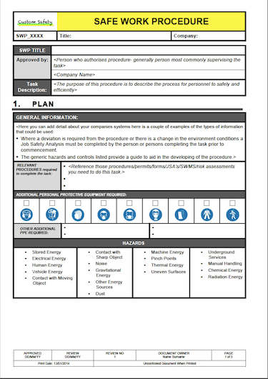
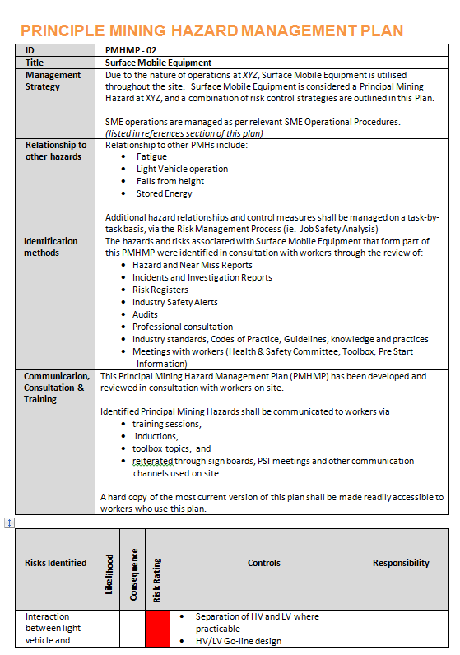
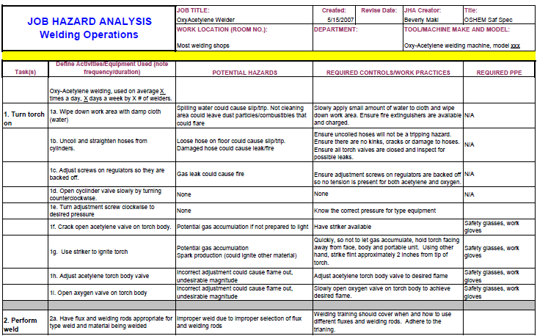
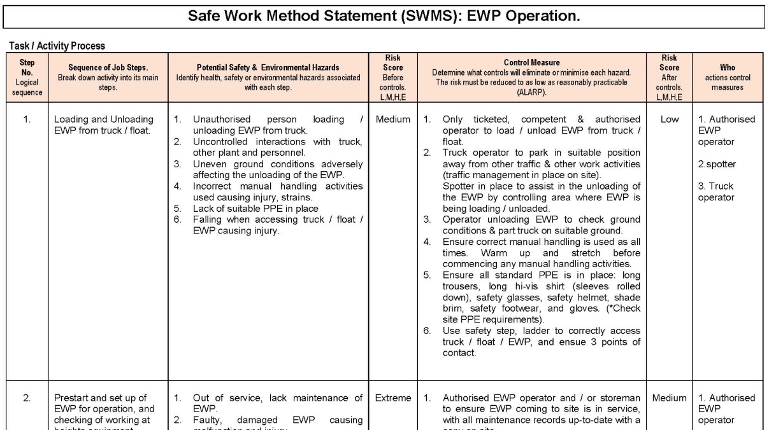
  Updating Affected Procedures
Safe Operating Procedure

Slide 31
  Communication of the Incident
Any information released to a workgroup about an incident must not include who was involved in the incident (a person’s name or their personal details) unless the worker signs a written consent.
Information that can be relayed includes:
Type of incident (injury, damage, near miss)
Nature of injury (strain, sprain, laceration)
Part of body (arm, leg, hand, finger)
Cause of injury (chemicals, struck, slip, trip)
Where and when it occurred
Root causes and causal factors
Actions to prevent reoccurrence.

Slide 32
  Communication of the Incident
Significant incidents should be communicated across the organisation by the Work Health and Safety person responsible for safety or Mine / Quarry Manager / Officer / PCBU.
This can be done via:
Emergency meetings
Pre-start meetings
Toolbox talks
Notice boards
Emails
Newsletters.

Slide 33
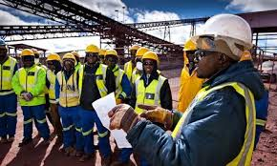
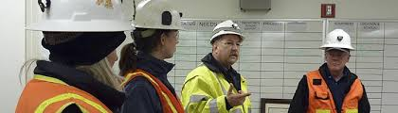
  Instruction and Training
Instruct and train workers in new or revised work instructions, polices and procedures.

Slide 34
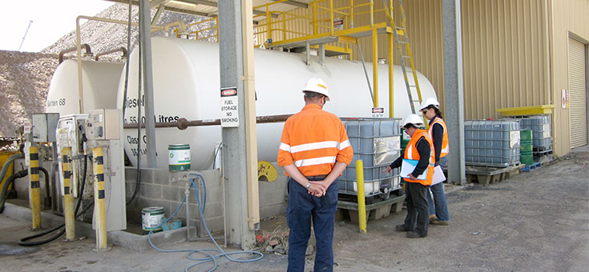
Inspection and Audits
Regularly conduct inspections and audits to ensure:
Risk controls are being implemented by workers
Any new hazards are identified with the task, plant, substances or environment
Any changes in a process are identified and addressed
Compliance with legislation.

Slide 35
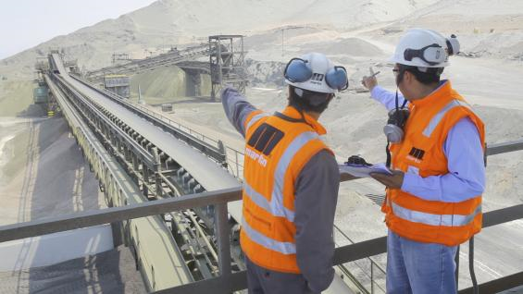
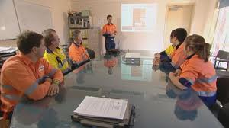
Monitor and Review Effectiveness
Control measures put in place to protect health and safety should be regularly monitored and reviewed to ensure:
  Risk controls are still effective
  Corrective actions are completed in a timely manner
  Continual improvement of risk control options.

Slide 36
Summary
PCBU
Primary duty of care to all workers on site by providing a working environment without risks to health and safety.
Duty to identify hazards and assess the risk to health and safety of workers.
Duty to eliminate the risk where possible or minimise the risk of harm (injury or damage) using reasonably practicable control measures.
Duty to provide information, instruction and training and resources as reasonably practicable to ensure the health and safety of all persons on site.
Supervisors and Team Leaders
Responsible for the day-to-day operations to ensure workers have received appropriate instruction, training, are adequately supervised and working safely.
Hazards and incidents are reported and recorded and risks are controlled within their limits of their role.

Slide 37
Summary
Workers
Inform their supervision when a hazard has been identified or an incident has occurred.
Not damage, remove or modify any plant, substance or thing that has been designed to protect his or her health and safety and the health and safety of others.
Follow any reasonable instruction from supervision while at work.
Not place themselves or any one else at risk of harm through his or her acts or omissions (actions or words).
Wear supplied personal protective equipment identified to protect them from hazards and risks associate with their work.

Slide 38
Further Assistance
MAQOHSC Work Health and Safety Specialists are available to provide further on-site support and assistance on all Work Health and Safety matters.
MAQOHSC Work Health and Safety Specialists can be contacted via our online support request form available on our website at www.maqohsc.sa.gov.au or email maqohsc@sa.gov.au.
Work Health and Safety Legislation, Codes of Practice, fact sheets, Health and Safety Representatives (HSR) information and guides can be found at the following websites:
SafeWork SA – www.safework.sa.gov.au or call 1300 365 255
Safe Work Australia – www.safeworkaustralia.gov.au or call 1300 551 832

