Slide 1
Basic Isolations and Lockout
April 2017

Slide 2
The Mining and Quarrying Occupational Health and Safety Committee
Promoting Work Health and Safety in the Workplace
This workplace industry safety presentation is developed and fully funded by the Mining and Quarrying Occupational Health and Safety Committee (MAQOHSC).
ISBN 978-1-925361-36-0

Slide 3
Disclaimer
IMPORTANT: The information in this presentation is of a general nature, and should not be relied upon as individual professional advice. If necessary, legal advice should be obtained from a legal practitioner with expertise in the field of Work Health and Safety law (SA).
Although every effort has been made to ensure that the information in this presentation is complete, current and accurate, the Mining and Quarrying Occupational Health and Safety Committee, any agent, author, contributor or the South Australian Government, does not guarantee that it is so, and the Committee accepts no responsibility for any loss, damage or personal injury that may result from the use of any material which is not complete, current and accurate.
Users should always verify historical material by making and relying upon their own separate inquiries prior to making any important decisions or taking any action on the basis of this information.

Slide 4
Creative Commons
This creative commons licence allows you to copy, communicate and or adapt our work for non-commercial purposes only, as long as you attribute the work to Mining and Quarrying Occupational Health and Safety Committee and abide by all the other licence terms therein.

Slide 5
Session Overview
This presentation will cover the following topics:
Hazardous energy sources
Isolation tools
Isolation process.

Slide 6
Definitions
Tagging - the process of placing a tag on equipment to alert others of potential hazards. This may be a personal danger tag, an out of service tag, a restricted operations or an information tag.
Isolation - prevention of energy sources in equipment.
This may include the use of locks, hasps, lock boxes, tags, permit to work systems.
Positive isolation - a physical barrier has been put in place to prevent all forms of energy irrespective of changes in conditions. The equipment is not able to be started and has been ‘tested for dead’.
Isolation point - a point or points used to remove / control the potential stored energy or source of energy from plant to make the plant safe to work on. e.g. battery, switch.

Slide 7
Why do we Isolate?
to protect
…people from harmful energy sources
…equipment from damage or further damage
…people from using unsafe equipment

Slide 8
Energies
Energy sources are varied, they are dangerous and their status may change over time. Of all of the energy sources, stored energies are the most likely to be generated during work activities.
Sources of stored energy in mobile and fixed plant include:
Hydraulics
Pneumatics
Electrical
Mechanical
Gravitational
Springs
Vacuum pressure
Thermal.

Slide 9
Hazardous Energy Sources
Compressed air
Water
Hydraulics
Electricity
Weights / gravity
Movement
Semi-solids
  Mobile plant
  Tyres
  Mine Services
  Pressure washers
  Mine pumps
  Water mains
  Mobile plant
  Fixed plant
  Fixed Installations
  ELV / LV / HV
  Temporary / mobile
  Mobile plant booms
  Conveyors
  Vehicles
  Motors / pumps
  Stored ore
  Moving parts – fixed plant
  Slurries
  Concentrates
  Tailings

Slide 10
Approved Isolation Points
Switches and circuit breakers
Plugs for electrical equipment
Blanks
Spades
Valves
Battery isolators on mobile equipment.

Slide 11
Prohibited Isolation Points
Emergency stop buttons
Lanyard switches (pull wires)
Control switches or stations
Instrument air valves.
If the isolation can be overridden,
it is not an isolation at all.

Slide 12


Isolation ‘Tools’ – Danger Tag
Danger tags (RED) – Issued to each individual with their photo and name on it for use with a danger lock.

Slide 13
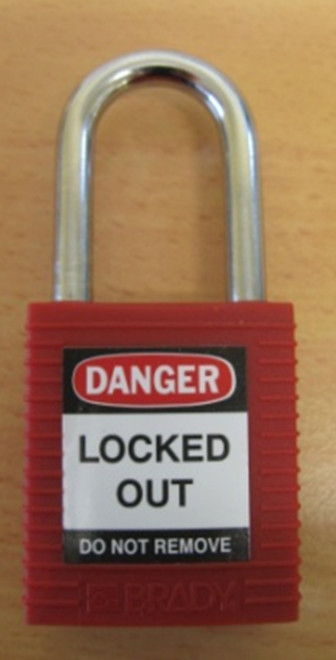
Isolation ‘Tools’ – Danger Lock
Danger locks (RED) – Uniquely keyed and issued for locking an isolation point.
Contractors need to supply their own red danger locks or sign for red danger locks that they are then responsible for returning.

Slide 14
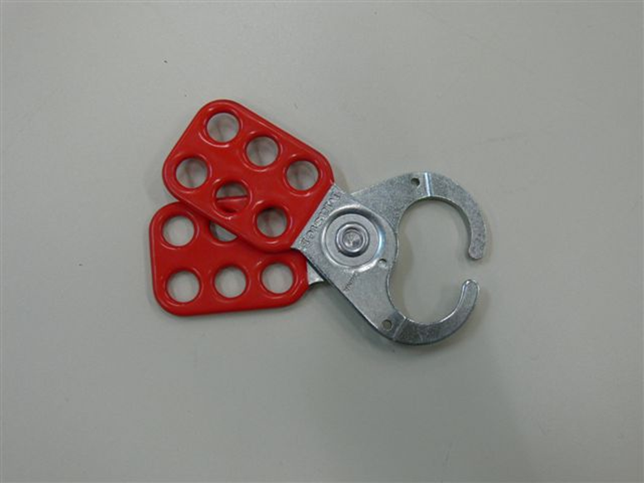
Hasp / Scissor Plate
A purpose-built device when used for plant isolation – it prevents the movement of an isolation point and allows the attachment of a number of locks.

Slide 15
Simple Isolation - Steps
Person initiating the isolation must…
Notify all people who may be affected by the isolation
Conduct Isolation
  Apply a hasp, or a device and hasp, to the isolation point
  Attach their personal danger lock and tag
  Check the security of the isolation (tamper resistance)
  ‘Test for Dead’ – check that there is no stored energy in the circuit / system / machine you are isolating.
All persons participating in the isolation must…
Attach their danger lock and danger tag to the hasp and remove it at the end of the task.

Slide 16
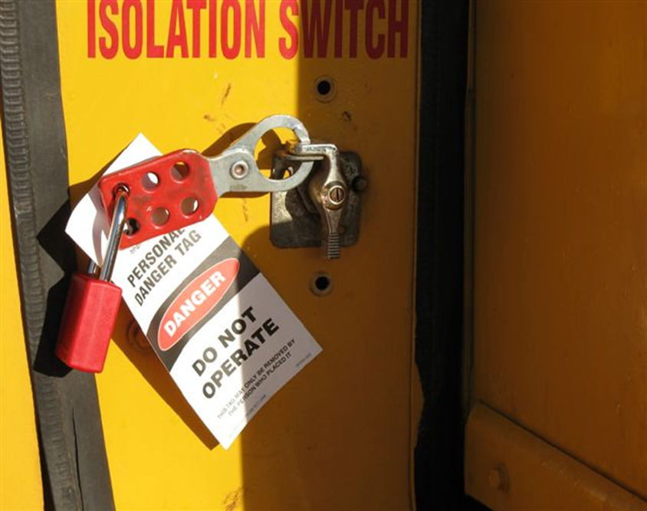
Completed Isolations
Note the use of scissor plate to isolation switch / battery isolator and placement of personal danger lock and personal danger tag.

Slide 17
Two ‘tests’ of Effective Isolation
Always ensure that an isolation:
Positively stops the flow and impact of energy
so that it protects all people.
Cannot be reactivated by another person
accidentally or intentionally.

Slide 18

Rules for Personal Danger Tags and Locks
Personal danger tags and locks must always
be used together.
Interference or operation could place you at
risk of severe injury or death.
No person shall attempt to operate an isolator
to which a danger tag / lock is attached.
Only you can place your personal danger lock / tag.
Only you can remove your personal danger lock / tag.
Your personal danger tag should not be left in place when you are no longer at risk.
If you fail to remove your tag / lock prior to leaving work, you will be required to return to work to remove it.
If you use a temporary personal danger tag make sure you fill out all the details.

Slide 19
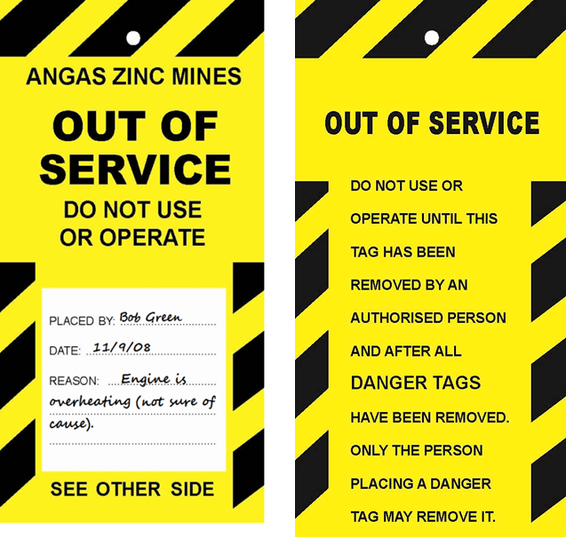
Out of Service Tags
If you have to leave plant in an unsafe condition you must attach an Out of Service Tag BEFORE you remove your personal danger lock and danger tag.

Slide 20

Using Out of Service Tags
An out of service tag is placed on an isolation point to indicate equipment may be
damaged and/or persons may be at risk if operated.
Can be placed when:
Equipment is defective
Equipment has a fault that could cause injury or damage
Repairs incomplete.
To use an out of service tag:
Clearly and legibly complete all items on the tag.
Securely attach tag to main isolation point of equipment or directly
onto equipment itself (if no isolation point).
Notify area supervisor.
Tag should only be removed once it is returned to a safe state by the person who carried out the repair or the person who rectified the hazard.

Slide 21
Further Assistance
MAQOHSC Work Health and Safety Specialists are available to provide further on-site support and assistance on all Work Health and Safety matters.
MAQOHSC Work Health and Safety Specialists can be contacted via our online support request form available on our website at www.maqohsc.sa.gov.au or email maqohsc@sa.gov.au.
Work Health and Safety Legislation, Codes of Practice, fact sheets, Health and Safety Representatives (HSR) information and guides can be found at the following websites:
SafeWork SA – www.safework.sa.gov.au or call 1300 365 255
Safe Work Australia – www.safeworkaustralia.gov.au or call 1300 551 832

