Slide 1
Health Surveillance Program 2015 – 2019
South Australian Mining and Quarrying Sector
Jan 2021

Slide 2
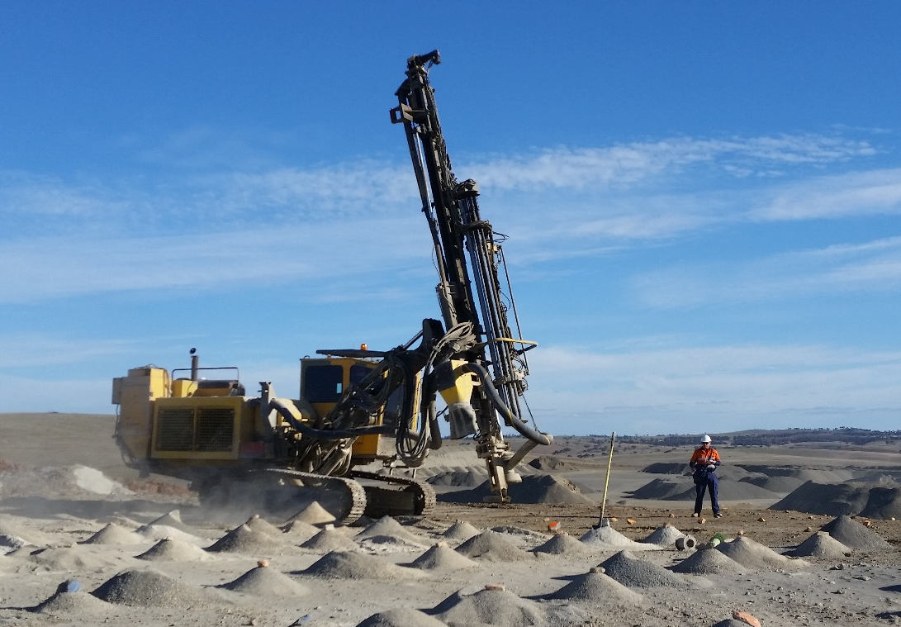
Program Objective
To assess whether workers in selected South Australian mines and quarries, are exposed to respirable dust and respirable crystalline silica (RCS) dust concentrations that may lead to an adverse risk to health.

Slide 3
Program Background
Greencap was awarded the contracts to conduct the dust monitoring in selected mines and quarries as part of the MAQHOSC Health Surveillance Program.
The monitoring was undertaken during the following periods:
2015/16 (January - April);
2016/17 (December to August); and
2018/19 (January to April).

Slide 4
Program Background
As part of the dust monitoring programs, additional assessments were undertaken.
Static noise measurements - 2016 & 2017.
Personal noise exposure - 2018.
Quantitative respirator fit testing - 2018.

Slide 5
Program Background
Site observations were made at each site during the monitoring relating to:
Implementation of current dust mitigation strategies, and
Use and adequacy of respiratory and hearing personal protective equipment.
The observations assisted the Occupational Hygienists in their assessment and recommendations on ways to reduce worker exposure to respirable dusts.

Slide 6
Program Overview
Number of Sites / Samples / Tests | Year of Program
 | 2015/16 | 2016/17 | 2018/19 | Total
Mine & Quarry Sites | 29 | 33 | 56 | 118
Personal Respirable Dust Samples | 138 | 299 | 308 | 745
Static Respirable Dust Samples | 47 | 147 | 243 | 437
Total Dust Samples | 185 | 446 | 551 | 1182
Static Noise Measurements | 260 | 306 | 0 | 566
Personal Noise Exposures | 0 | 0 | 190 | 190
Respirator Fit Tests | 0 | 0 | 264 | 264

Slide 7
Exposure Standards and Guidelines
Airborne Dust
Criteria used to assess occupational exposures to crystalline silica in the workplace were based on the workplace exposure standards (WES) published by Safe Work Australia in the Workplace Exposure Standards for Airborne Contaminants - 2013 & 2018 editions.

Slide 8
Exposure Standards and Guidelines
Airborne Dust
The WES is defined as a time-weighted average (TWA) exposure for a normal eight-hour workday over a five-day working week, to which nearly all workers are be repeatedly exposed to.
As no WES existed for Respirable Dust, Greencap adopted the trigger value developed by the Australian Institute of Occupational Hygienists (AIOH).

Slide 9
Respirable Dust Sampling Standard
Airborne Dust
Respirable Dust and Respirable Crystalline Silica dust concentrations were measured in accordance with:
Australian Standard AS2985-2009, Workplace atmospheres – Method for sampling and gravimetric determination of respirable dust.

Slide 10
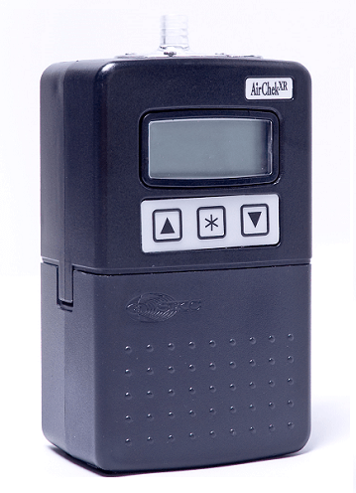
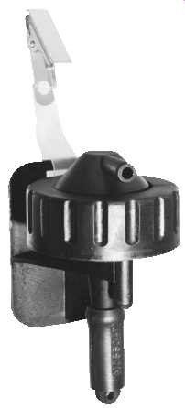
Sampling Equipment
A pre-weighed PVC membrane filter mounted into an SKC plastic cyclone sampling head and connected to a SKC portable sampling pump via plastic tubing.

Slide 11
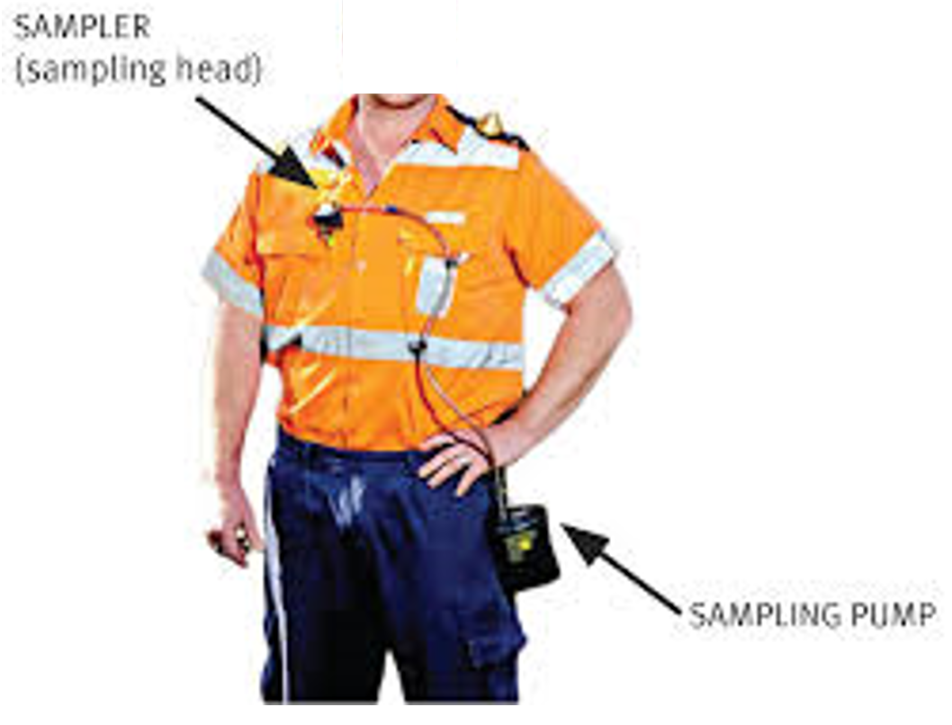
Sampling Equipment
The sampling pump was clipped to the workers belt / waist band and the cyclone filter to the collar of the worker’s shirt / jacket.

Slide 12
Similar Exposure Groups
A similar exposure group (SEG) is a group of workers having the same general exposure profile because of:
Similarity and frequency of the tasks they perform;
Materials and processes they work with or carry out; and
Similarities of the way they perform the tasks.
The SEG list was previously developed during monitoring conducted in 2009, 2012 and 2013, and was continued into the 2016, 2016/17 and 2018 programs.

Slide 13
Similar Exposure Groups
SEG Code | Similar Exposure Group (SEG)
1 | Driller, Drilling & Cutting
2 | Blast Crew
3 | Truck Driver, Dump
4 | Crusher Operator
5 | Loader Operator
6 | Truck Driver, Bin & other
7 | Quarry Supervisor/Manager
8 | Excavator
9 | Pug Mill Operator
10 | Lab Tech
SEG Code | Similar Exposure Group (SEG)
11 | Mine Technicians
12 | Surveyors and Geologists
13 | Maintenance Worker
14 | Dozer Operator
15 | Water Truck Driver
21 | Loader Operator/Crusher Operator
22 | Bagging
23 | Other Tasks (not included in SEGs)
24 | Quarryman

Slide 14
Respirable Dust Sampling
A total of 1182 respirable dust samples were collected from 118 sites from December 2016 until April 2018.
Of those samples collected:
745 (63% ) were personal samples; and
437 (37%) were static samples. (Static measurements were taken at 1.5m above ground).
All respirable dust samples were further analysed for crystalline silica content. (0.1 mg/m3)

Slide 15
Personal Respirable Dust Results
Of the 745 personal respirable dust samples collected:
84 (11%) respirable dust samples exceeded the AIOH Trigger Value for respirable dust.
79 (11%) exceeded the respirable crystalline silica dust workplace exposure standard.

Slide 16
Static Respirable Dust Results
Of the 437 static respirable dust samples collected:
70 (16%) respirable dust samples exceeded the AIOH Trigger Value for respirable dust; and
62 (14%) exceeded the respirable crystalline silica dust WES.
(Note: static samples do not represent worker exposures).

Slide 17
Respirable Dust Exceedances by SEG
Total of 84 personal exceedances recorded.
SEG Number | SEG Name | No. of Exceedances | % of Exceedances | Rank
4 | Crusher Operator | 19 | 23 | 1
13 | Maintenance Worker | 12 | 14 | 2
24 | Quarryman | 10 | 12 | 3
3 | Truck Driver, Dump | 9 | 11 | 4
5 | Loader Operator | 8 | 10 | 5
7 | Quarry Supervisor/Manager | 7 | 8 | 6
1 | Driller, Drilling & Cutting | 6 | 7 | 7
23 | Other Tasks (not included in SEG) | 5 | 6 | 8
8 | Excavator | 4 | 5 | 9
6 | Truck Driver, Bin & other | 2 | 2 | 10
11 | Mine Technicians | 1 | 1 | 11
15 | Water Truck Driver | 1 | 1 | 11

Slide 18
Respirable Silica Exceedances by SEG
Total of 79 personal exceedances recorded.
SEG Number | SEG Name | No. of Exceedances | % of Exceedances | Rank
4 | Crusher Operator | 15 | 19 | 1
5 | Loader Operator | 11 | 14 | 2
13 | Maintenance Worker | 10 | 13 | 3
24 | Quarryman | 9 | 11 | 4
3 | Truck Driver, Dump | 8 | 10 | 5
1 | Driller, Drilling & Cutting | 8 | 10 | 5
8 | Excavator | 4 | 5 | 7
7 | Quarry Supervisor/Manager | 3 | 4 | 8
11 | Mine Technicians | 3 | 4 | 8
2 | Blast Crew | 3 | 4 | 8
23 | Other Tasks (not included in SEG) | 2 | 3 | 11
6 | Truck Driver, Bin & other | 1 | 1 | 12
15 | Water Truck Driver | 1 | 1 | 12
22 | Bagging | 1 | 1 | 12

Slide 19
Respirable Dust Exceedances by Mineral
Total of 85 personal exceedances were recorded against the following minerals.
Mineral Type | No. of Exceedances | % of Exceedances | Rank
Dolomite | 16 | 19 | 1
Limestone | 16 | 19 | 1
Marble | 14 | 17 | 3
Ore | 11 | 13 | 4
Quartzite | 9 | 11 | 5
Slate | 5 | 6 | 6
Sandstone | 4 | 5 | 7
Granite | 4 | 5 | 7
Sand | 3 | 4 | 9
Basalt | 2 | 2 | 10

Slide 20
Respirable Silica Exceedances by Mineral
Total of 79 personal exceedances were recorded against the following minerals.
Mineral Type | No. of Exceedances | % of Exceedances | Rank
Dolomite | 25 | 32 | 1
Ore | 16 | 20 | 2
Quartzite | 11 | 14 | 3
Slate | 9 | 11 | 4
Sandstone | 6 | 8 | 5
Sand | 5 | 6 | 6
Limestone | 4 | 5 | 7
Marble | 3 | 4 | 8

Slide 21
Respiratory Fit Testing
Quantitative respiratory fit testing was conducted in accordance with:
Australian Standard 1715: Selection, use and maintenance of respiratory protective equipment.
Respirators Fit Testing (RFT) was conducted on site using a TSI PortaCount® Pro+ Respirator Fit Tester 8038.
The PortaCount® measures the particle concentration simultaneously inside and outside of the respirator whilst it is being worn by the worker.

Slide 22
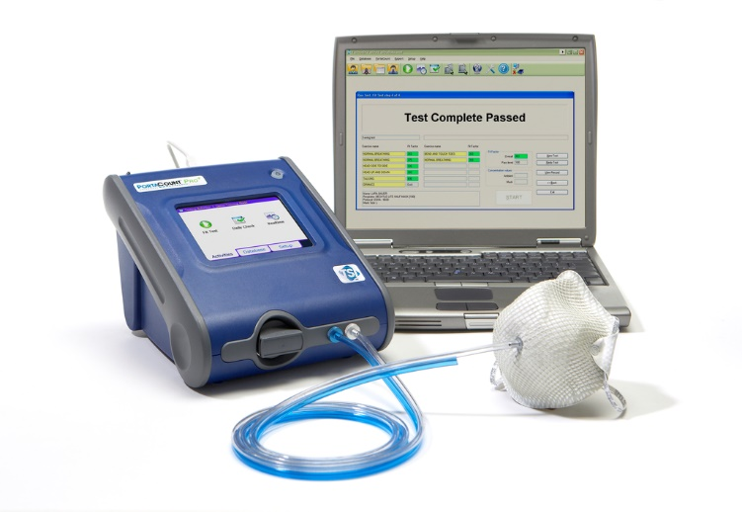
Respiratory Fit Testing
It calculates the fit factor of the respirator which is the ratio of the two concentrations.
Elevated particle concentrations on the inside of the respirator can be attributed to face seal leakage.

Slide 23
Respiratory Fit Testing Results 2018
Of the 264 fit tests conducted during the 2018 program,
120 (45.5%) failed to meet a fit factor of 10.
Of the 144 tests which passed the fit factor of 10,
68 (47.2%) of these also passed a fit factor test of 50.

Slide 24
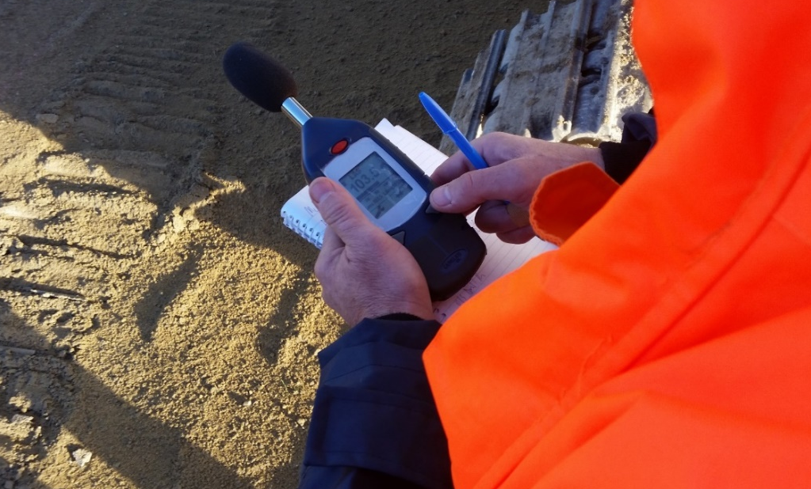
Noise Measurements
Noise level exposure standards are presented in Chapter 4, Part 1 of the SA Work Health and Safety Regulations 2012.
The regulations present an exposure standard to which an employer must ensure an employee whilst at work, does not exceed.

Slide 25
Noise Measurements
The exposure standard is defined as;
an eight-hour equivalent continuous A-weighted sound pressure level, LAeq8h of 85 dB(A) referenced to 20 micropascals; and
a C-weighted peak sound pressure level, Lpeak of 140dB(C) referenced to 20 micropascals.

Slide 26
Noise Measurements
For workers working extended work shifts (10 hours or longer per day), an adjustment in accordance of Australian/ New Zealand Standard 1269.1:2005 Occupational Noise Management Part 1: Measurement of noise immission & exposure was added to the eight-hour normalised noise exposure level.
None of the workers monitored worked work shifts greater than 12 hours so the adjustment level for these workers was 1 dB(A).

Slide 27
Noise Levels
Noise Level dB(A) | Exposure Time before Standard is Exceeded
80 | 16 Hours
82 | 12 Hours
85 | 8 Hours
88 | 4 Hours
91 | 2 Hours
94 | 1 Hour
97 | 30 Minutes
100 | 16 Hours
100 | 15 Minutes
103 | 7.5 Minutes
106 | 3.8 Minutes
109 | 1.9 Minutes
112 | 57 Seconds
115 | 28.8 Seconds
100 | inutes
118 | 14.4 Seconds
121 | 7.2 Seconds
124 | 3.6 Seconds
127 | 1.8 Seconds
130 | 0.9 Seconds

Slide 28
Noise Levels
Example:
Exposure to 94 dB(A) for approximately one hour without hearing protection, is the equivalent of 8 hours exposure at 85 dB(A).
Prolonged exposure to such noises without adequate hearing protection is likely to result in temporary or permanent hearing damage.

Slide 29
Typical Sound Levels
Sound Level in dB(A) | Sound Source
140 | Jet Engine at 30m
130 | Rivet Hammer( pain can be felt at this threshold
120 | Rock drill
110 | Chainsaw
100 | Sheet metal Workshop
90 | Lawnmower
85 | Front End Loader
110 | 4 Hours
80 | Kerbside Heavy Traffic / Lathe
70 | Loud Conversation
60 | Normal Conversation

Slide 30
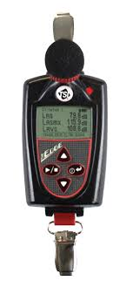
Noise Measurements
Static noise measurements were taken using a hand held TSI Quest SoundPro SE/DL sound Level meter.
Personal noise exposures were made using TSI Quest The Edge 5 dosimeters.
Dosimeter was clipped to the workers collar/ shirt area approximately 10cm horizontally from the ear

Slide 31
Personal Noise Exposure 2018
Of the 190 personal noise exposures measured in 2018:
83 (43.7%) exceeded the exposure standard of 85 dB(A).
34 (17.9%) exceeded the peak noise exposure standard of 140 dB(C).

Slide 32
Static Noise Measurement 2016-2017
Static noise measurements cannot be directly attributed to a worker noise dose.
However, of the 566 static noise measurements taken in the 2016 and 2016/17 programs:
393 (69%) exceeded a sound pressure level 85 dB(A).

Slide 33
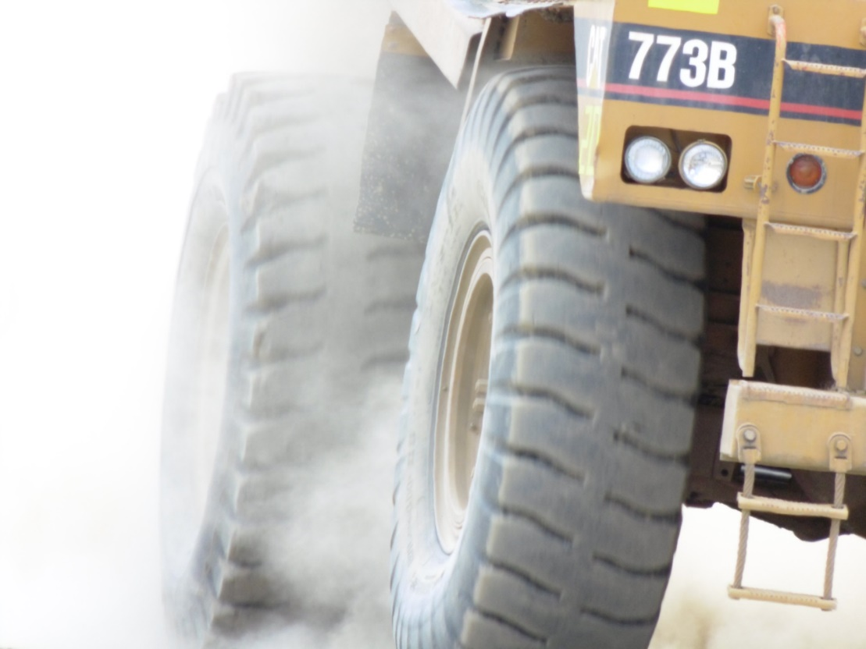
Summary
The respirable dust and respirable crystalline silica dust results showed approximately 11% of the samples exceeded the AIOH Trigger value or the workplace exposure standard.

Slide 34
Summary
Majority of respirable dust exposure level exceedances were from the following SEGs:
Crusher operators;
Maintenance workers;
Quarryman; and
Dump truck operators

Slide 35
Summary
Top 4 minerals that were associated with personal respirable dust exposure standard exceedances in the program:
Dolomite;
Limestone;
Marble;
Metal Ores.

Slide 36
Summary
Majority of respirable crystalline silica exposure level exceedances were from the following SEGs:
Crusher operators;
Loader operators;
Maintenance workers;
Quarryman.

Slide 37
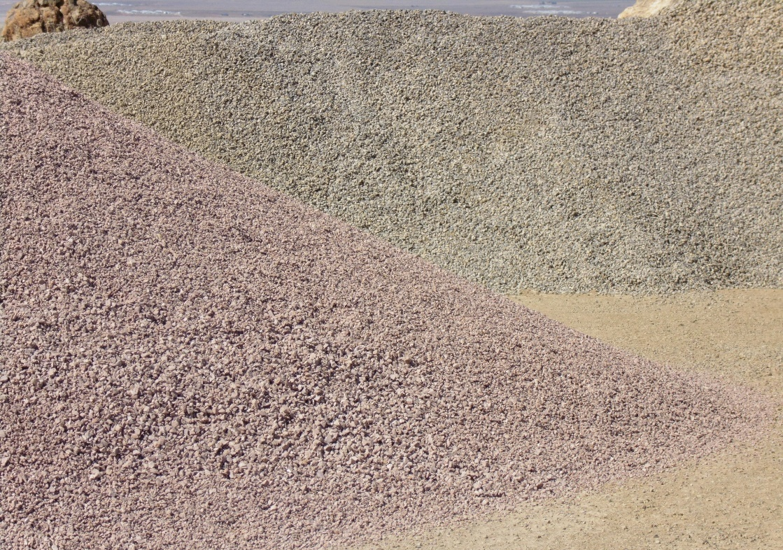
Summary
Top 4 minerals that were associated with personal respirable crystalline dust exposure standard exceedances in the program:
Dolomite;
Metal Ores;
Quartzite;
Slate.

Slide 38
Summary
From observations made during the course of the programs:
Crusher operators and quarryman “generally” received their dust exposures from spending a good proportion of time in and around the crushing plant when in operation.
Maintenance workers received their dust exposures from working in and around operating crushing plants, as well as during plant shutdown for repairs or scheduled maintenance.

Slide 39
Summary
Dump truck and loader operators received their dust exposures from:
Unsealed cabins (windows / doors open, poor door seals etc.);
Filtration and air conditioning systems not being maintained; and
Airborne dust raised on haul and access roads.

Slide 40
Summary
Of the 56 sites visited in the 2018 program, just under half (46%) had no engineering dust control measures operating on the day of the monitoring.

Slide 41
Summary
Of 264 respirator fit test conducted during the 2018 program, 120 workers or 45.5% of workers fit tested, failed achieve the required respiratory protection fit factor, due to 1 or more of the following:
Respirator was not flexible to mould to the workers facial features; or
Respirator was the wrong size for the face; or
Worker had facial hair / growth that interfered with the respirator seal on the face.

Slide 42
In Conclusion
When we apply the new respirable crystalline silica WES of 0.05 mg/m3 over an 8hr time weighted average period, (effective as of 1st July 2020):
The exposure levels of the 11% of workers who exceeded the old WES, have now double, and
Workers who previously recorded an exposure level equal to or greater than the old action level (50% of WES), are now at or above the new WES.

Slide 43
In Conclusion
South Australian mine and quarry operators have significant challenges ahead of them to ensure that no person at the workplace is exposed to hazardous noise levels, or respirable dust and respirable crystalline silica concentrations above the relevant exposure standards.

Slide 44
In Conclusion
In managing risks associated with noise, mine and quarry operators must:
identify noisy activities that may expose a worker to hazardous noise levels; and
carry out a noise assessment to identify who is at risk of suffering a hearing loss,
eliminate the risk to the workers health, or
implement risk controls to reduce the workers noise exposure level, to below the exposure standard.

Slide 45
In Conclusion
Additionally, where a worker is frequently required to wear hearing protection to protect them from hearing loss associated with noise, a mine or quarry must provide audiometric testing for the worker:
within 3 months of commencing work, and
at least every 2 years.

Slide 46
In Conclusion
In managing risks associated with respirable dust and respirable crystalline silica, mine and quarry operators must carry out air monitoring (personal and static) to determine:
whether the airborne concentrations of respirable dust and respirable crystalline silica at the workplace, exceeds the relevant exposure standard, and
whether there is a risk to health from exposure.

Slide 47
In Conclusion
Where it is identified that a worker’s exposure levels exceed the relevant workplace exposure standard, a mine or quarry operator must:
eliminate the risk to the workers health, or
implement risk controls to reduce the workers exposure level, to below the exposure standard.
Health monitoring must also be carried out on the worker, where a mine or quarry operator determines that there is a significant risk of an adverse effect on the worker's health because of the worker's exposure.

Slide 48
Further Information and Assistance
Work, Heath and Safety Legislation, Codes of Practice, fact sheets and guides on managing risks in the workplace associated with noise, respirable dust and respirable crystalline silica, can be found at the following websites:
Safe Work Australia – www.safeworkaustralia.gov.au
MAQOHSC – www.maqohsc.sa.gov.au
SafeWork SA – www.safework.sa.gov.au

Slide 49
Further Information and Assistance
MAQOHSC is also available to provide guidance, onsite support and advice on WHS Matters.
To contact MAQOHSC, please visit our website at:
www.maqohsc.sa.gov.au and make a request for support.
Alternatively, if you would like to speak with someone in relation to eel free to contact us on: (08) 8204 9842
Think Safety
Work Safely!

