Slide 1
Workplace Induction and Orientation
June 2017

Slide 2
The Mining and Quarrying Occupational Health and Safety Committee
Promoting Work Health and Safety in the Workplace
This workplace industry safety presentation is developed and fully funded by the Mining and Quarrying Occupational Health and Safety Committee (MAQOHSC).
ISBN 978-1-925361-48-3

Slide 3
Disclaimer
IMPORTANT: The information in this presentation is of a general nature, and should not be relied upon as individual professional advice. If necessary, legal advice should be obtained from a legal practitioner with expertise in the field of Work Health and Safety law (SA).
Although every effort has been made to ensure that the information in this presentation is complete, current and accurate, the Mining and Quarrying Occupational Health and Safety Committee, any agent, author, contributor or the South Australian Government, does not guarantee that it is so, and the Committee accepts no responsibility for any loss, damage or personal injury that may result from the use of any material which is not complete, current and accurate.
Users should always verify historical material by making and relying upon their own separate inquiries prior to making any important decisions or taking any action on the basis of this information.

Slide 4
Creative Commons
This creative commons licence allows you to copy, communicate and or adapt our work for non-commercial purposes only, as long as you attribute the work to Mining and Quarrying Occupational Health and Safety Committee and abide by all the other licence terms therein.

Slide 5
Workplace Inductions
The purpose of workplace inductions and site orientations are to familiarise and provide workers with an understanding about:
Company requirements
Health and safety duties and obligations, and
Their working environment
prior to commencing work within a company.

Slide 6

Workplace Inductions

Slide 7
Legislation
Work Health and Safety Act 2012 (SA)
Section 19 - Primary duty of care
The Work Health and Safety Act 2012 (SA) requires that a person conducting a business or undertaking (PCBU) must ensure, so far as is reasonably practicable:
the provision of any information, training, instruction or supervision that is necessary to protect all persons from risks to their health and safety arising from work carried out.

Slide 8
Legislation
Work Health and Safety Regulations 2012 (SA)
Regulation 39 - Provision of information, training and instruction
The person must ensure that information, training and instruction provided to a worker is suitable and adequate having regard to:
the nature and associated risks with their work; and
the risk control measures implemented; and
can be understood by any person whom reads it.

Slide 9

Workplace Inductions
Induction requirements should be determined using information sourced from:
Legislative requirements
Site specific competencies
Training needs analysis (TNA)
Risk management processes
Work Health and Safety Management System, and
Standards applicable to site.

Slide 10
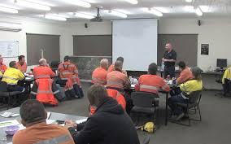
Workplace Inductions
When creating the induction program, ensure you consider:
Workers literacy levels
The amount of information to be absorbed, and
How engaging is the information.

Slide 11
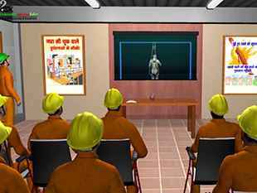
Workplace Inductions
Inductions with pages of text and hard to understand legislative requirements may result in workers forgetting or not understanding important information.
Pictures and film clips will make the program more interesting and entertaining and keep workers engaged.

Slide 12
Workplace Inductions
Induction programs should:
Be delivered by a competent person, and
Have a questionnaire / assessment to verify workers have understood and retained the information.
Note:
Include assessment questions throughout the induction, not just at the end.
Completing questionnaires / assessments at the very end of an induction and remembering information from the beginning can be difficult.
Check whether any workers have literacy problems, and if necessary verbalise the assessment with them.

Slide 13

Workplace Inductions
Inductions programs should be reviewed:
Regularly to ensure the information delivered is still current, and
Where there has been a change in a policy, procedure, process or work area.

Slide 14
Workplace Inductions
The induction should include:
A company overview
Terms and conditions of employment
Company policies and procedures
Work Health and Safety legislative requirements
Note:
Depending on the organisations structure, the terms and conditions of employment may be completed separately to the induction with the Human Resources team.

Slide 15
Workplace Inductions
The induction should include:
Principal Mining and site specific hazards
Principles of risk management
Systems for injury and illness prevention
Worker’s Compensation and Injury Management, and
Key personnel (Health and Safety Representatives, First Aiders, Fire Wardens).

Slide 16
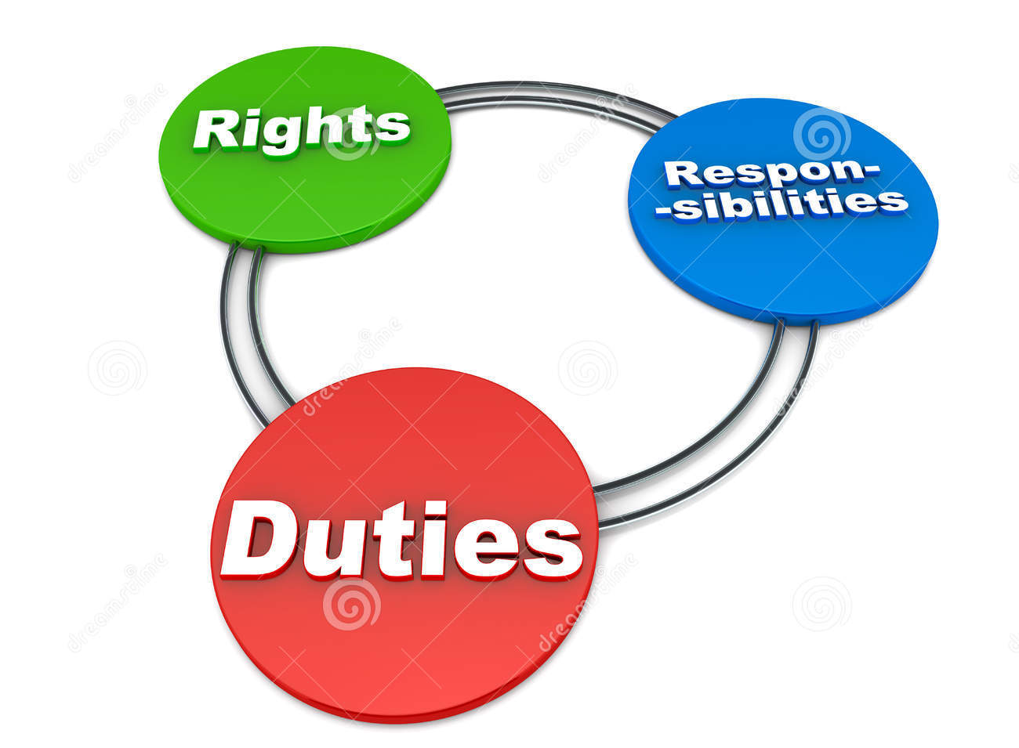
Workplace Inductions
The induction should explain:
The obligations of PCBUs and workers, including duty of care under the Work Health and Safety Act and Regulations 2012 (SA)
Key policies and procedures relating to workers
Expectations of workers and required behaviours

Slide 17
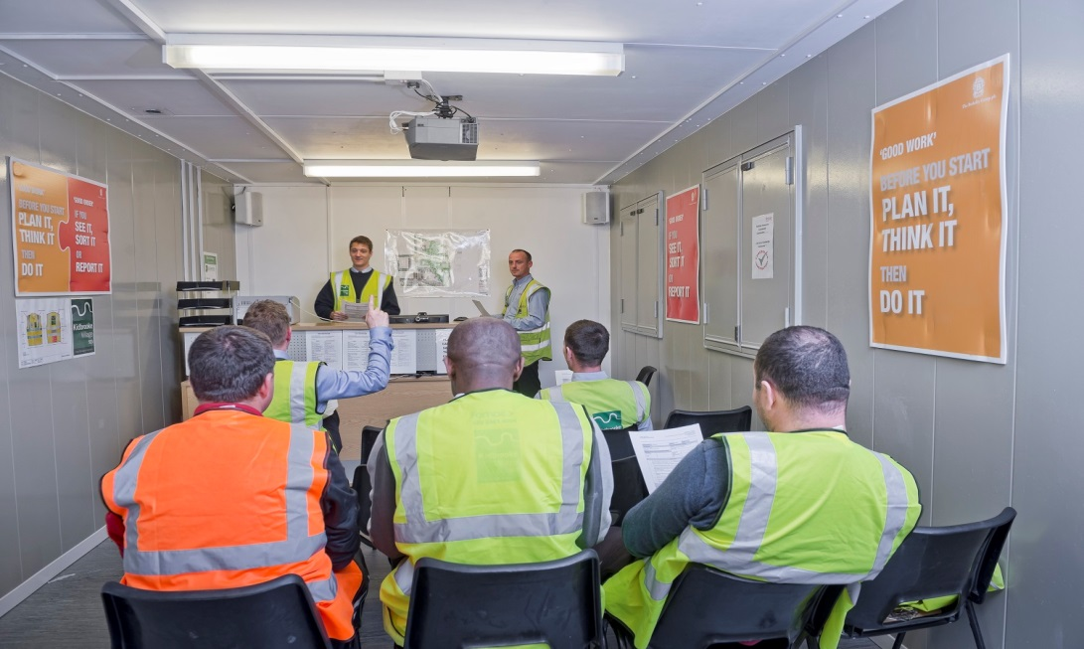
Workplace Inductions
The induction should explain:
Work Health and Safety consultation and communication procedures
Reporting processes, including hazards, incidents and injuries
Roles and functions of Health and Safety Representatives and Health and Safety Committees

Slide 18

Workplace Inductions
The induction should explain:
Common site hazards, including principal mining hazards and their risk control measures
The safety role for workers
Basic risk management principles and tools used on site
Site layout and emergency assembly points, and
Emergency contact numbers and response procedures.

Slide 19

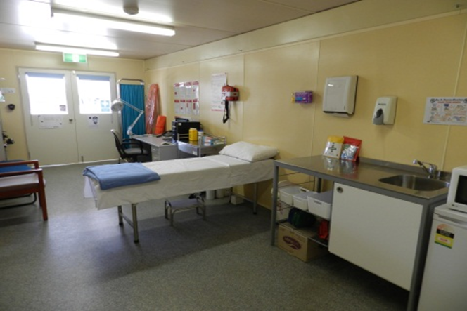
Orientation
Site orientations are conducted to familiarise workers with:
Key site personnel
Evacuation assembly points
First aid facilities
Buildings and amenities
Fire fighting equipment for the area
Working areas

Slide 20

Orientation
Site orientations are conducted to familiarise workers with:
Site specific personal protective equipment location requirements
Plant and equipment
Area hazards and controls
Exclusion zones, and
Parking areas.

Slide 21
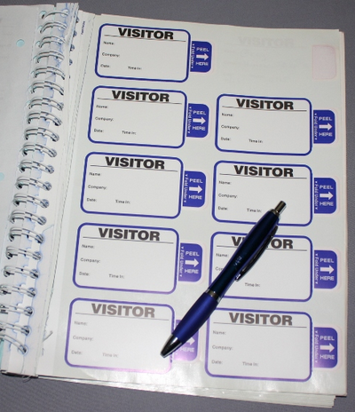

Visitor Inductions
Visitor inductions are conducted to inform visitors what is expected of them while on site.
It may include limitations and the rules for tasks being performed, and requirements for a site escort.
Visitor inductions should also describe the emergency response procedures and where evacuation points are located.

Slide 22
MAQOHSC Industry Induction Tools
MAQOHSC has developed key induction documents for the mining and quarrying industry:
Induction Policy and Procedure Templates
Induction Manual Template
Induction and Orientation Checklist
These documents are not exhaustive and will need to be specifically tailored to your site requirements.
A Workplace Induction Guide has also been developed to assist the mining and quarrying industry.

Slide 23
MAQOHSC Industry Induction Tools
Throughout the documentation, there are locations where information is to be inserted and examples are to be replaced with real company information.
For example:
Company name
Address and location
Overview about the company
Position titles (who is responsible)
Contact names and numbers.

Slide 24
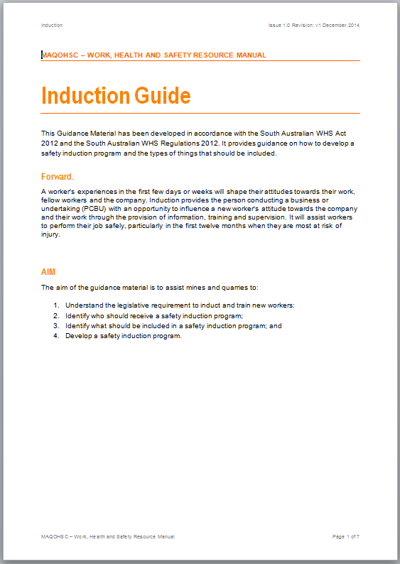

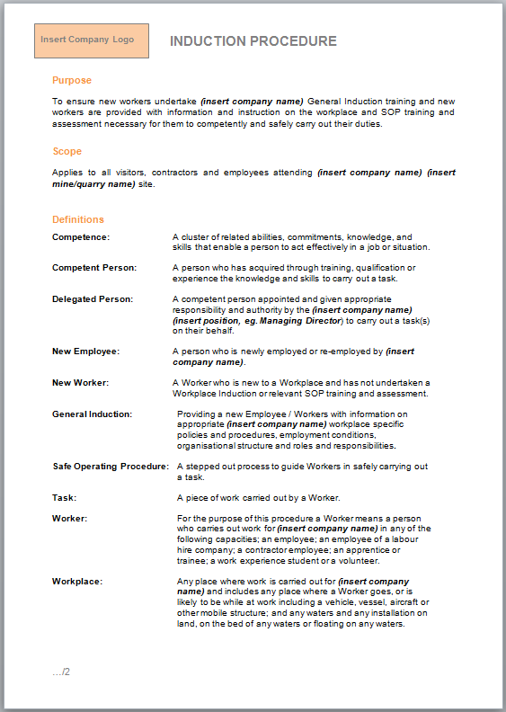
MAQOHSC Induction Guide, Policy and Procedure

Slide 25
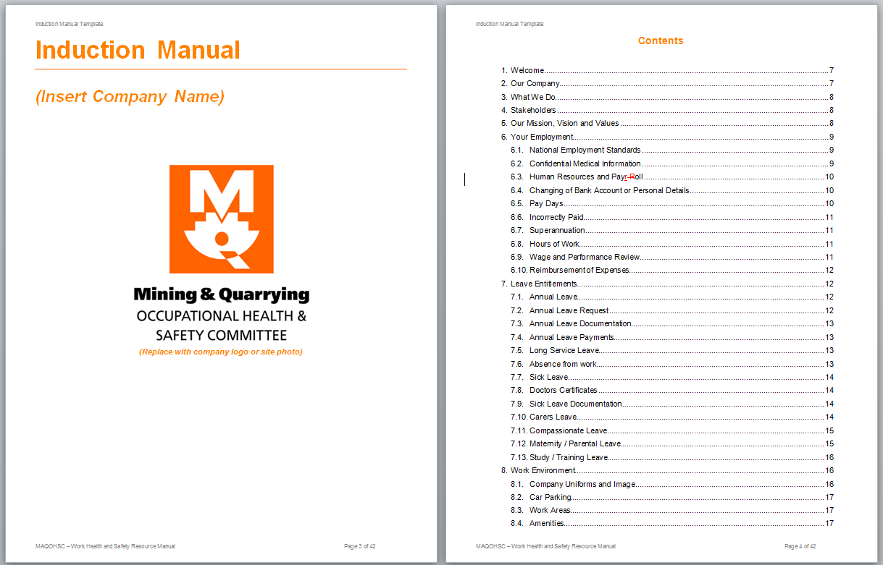
MAQOHSC Induction Manual

Slide 26
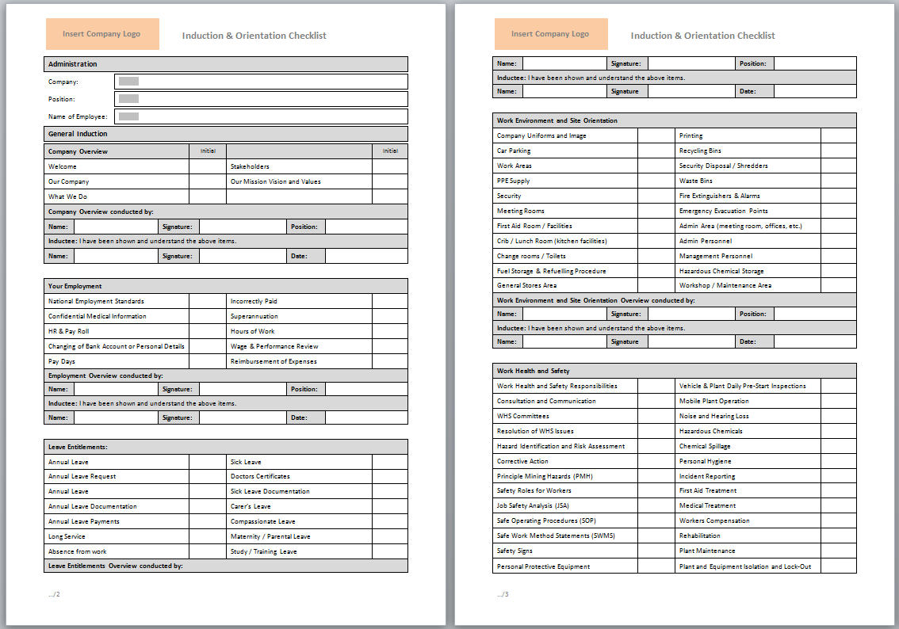
MAQOHSC Induction and Orientation Checklist

Slide 27
Further Assistance
MAQOHSC Work Health and Safety Specialists are available to provide further on-site support and assistance on all Work Health and Safety matters.
MAQOHSC Work Health and Safety Specialists can be contacted via our online support request form available on our website at www.maqohsc.sa.gov.au or email maqohsc@sa.gov.au.
Work Health and Safety Legislation, Codes of Practice, fact sheets, Health and Safety Representatives (HSR) information and guides can be found at the following websites:
SafeWork SA – www.safework.sa.gov.au or call 1300 365 255
Safe Work Australia – www.safeworkaustralia.gov.au or call 1300 551 832

