Slide 1
Personal Protective Equipment
April 2017

Slide 2
The Mining and Quarrying Occupational Health and Safety Committee
Promoting Work Health and Safety in the Workplace
This workplace industry safety presentation is developed and fully funded by the Mining and Quarrying Occupational Health and Safety Committee (MAQOHSC).
ISBN 978-1-925361-42-1

Slide 3
Disclaimer
IMPORTANT: The information in this presentation is of a general nature, and should not be relied upon as individual professional advice. If necessary, legal advice should be obtained from a legal practitioner with expertise in the field of Work Health and Safety law (SA).
Although every effort has been made to ensure that the information in this presentation is complete, current and accurate, the Mining and Quarrying Occupational Health and Safety Committee, any agent, author, contributor or the South Australian Government, does not guarantee that it is so, and the Committee accepts no responsibility for any loss, damage or personal injury that may result from the use of any material which is not complete, current and accurate.
Users should always verify historical material by making and relying upon their own separate inquiries prior to making any important decisions or taking any action on the basis of this information.

Slide 4
Creative Commons
This creative commons licence allows you to copy, communicate and or adapt our work for non-commercial purposes only, as long as you attribute the work to Mining and Quarrying Occupational Health and Safety Committee and abide by all the other licence terms therein.

Slide 5
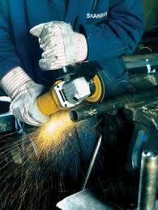
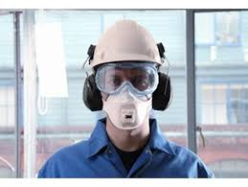
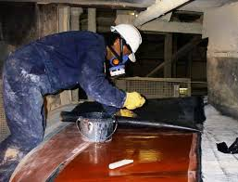
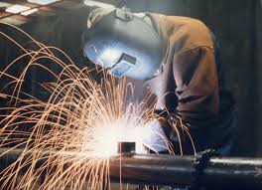
PPE

Slide 6
Session Overview
What is personal protective equipment (PPE)?
Who is responsible?
Risk management definitions
Hazard identification and risk management process
Hierarchy of control
Control measures
Information and instructions on PPE requirements
PPE Care and maintenance
Summary.

Slide 7
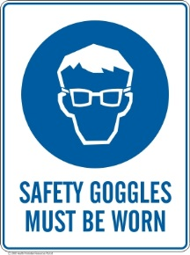

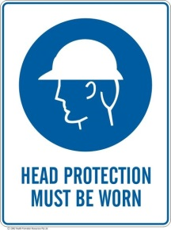


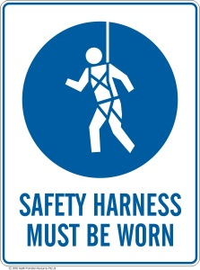
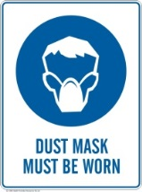
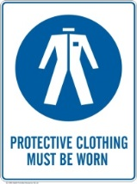

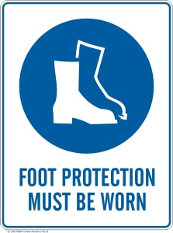

What is PPE?
Personal protective equipment (PPE), is any clothing, equipment or substance designed to protect you from hazards in the workplace.

Slide 8


What is PPE?
The following list identifies parts of the body which PPE is commonly used to protect, and some common sources of risk which may be controlled by PPE.
Eye and face protection such as goggles, glasses and face shields protect from flying objects, sparks, UV, bright lights and splashing substances
Head protection such as hair nets, sun hats, safety helmets (hard hats) provide protection from hair being entangled in machinery, exposure to the sun and being struck by falling, expelled objects
Hearing protection such as ear muffs and ear plugs provide protection from excessive / loud noise

Slide 9
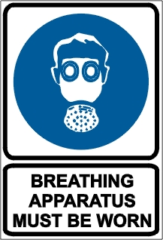

What is PPE?
Foot protection such as steel capped safety and rubber boots provide protection from crushing, slipping, abrasion, irritant substances, wetness, puncture and cold / heat
Respiratory protection such as dust masks and respirators provide protection from dust, fumes, vapours and aerosols
Protective clothing such as high visibility vests, wet weather jackets for the rain and cold, safety harnesses to prevent falling from height, aprons provide protection from sparks, hot molten metal and chemicals
Hand protection such as gloves and barrier creams provide protection from abrasion, sparks, irritant substances and vibration

Slide 10
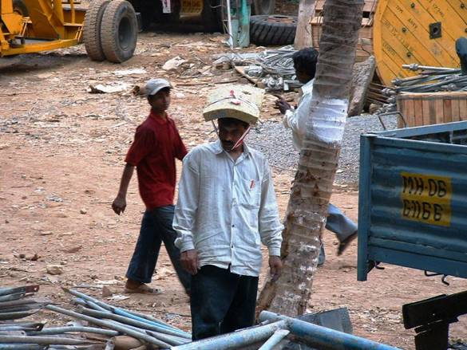
Head Protection

Slide 11
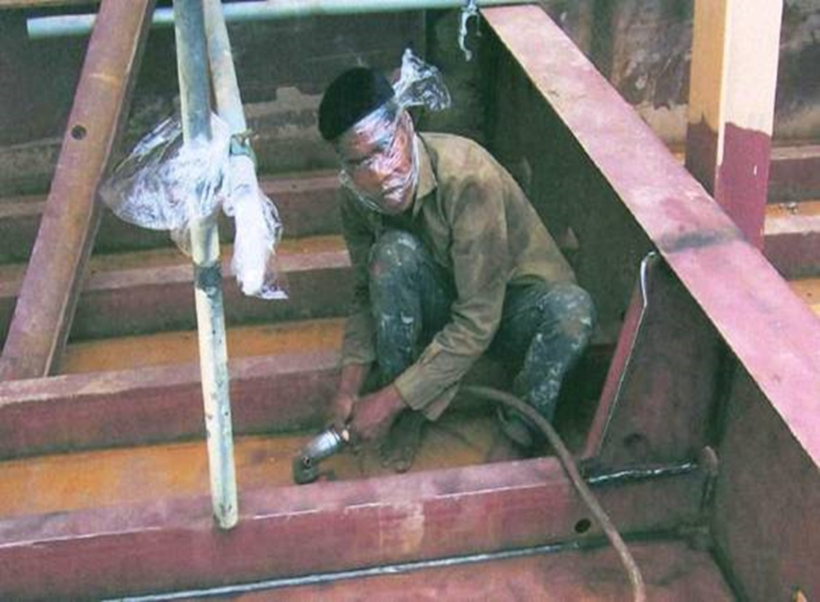
Safety Glasses

Slide 12
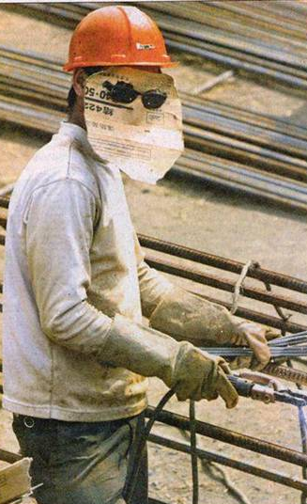
Face Shield

Slide 13

Who is Responsible?
Under the Work Health and Safety Act 2012 (SA):
Section 19 - Primary Duty of Care
A person conducting a business or undertaking (PCBU) must ensure, so far as is reasonably practicable, the health and safety of:
workers engaged, or caused to be engaged
  workers whose activities in carrying out work are influenced or directed while the workers are at work
  other persons (visitors and volunteers) are not put at risk from work carried out as part of the business activities.

Slide 14
Who is Responsible?
Under the Work Health and Safety Act 2012 (SA):
Section 19 - Primary Duty of Care
A PCBU must ensure, so far as is reasonably practicable the provision and maintenance of:
a work environment without risks to health and safety
  safe plant, structures and safe systems of work
  the safe use, handling and storage of plant, structures and substances
  provide any information, training, instruction or supervision that is necessary to protect all persons from risks to their health and safety.

Slide 15
Who is Responsible?
Under the Work Health and Safety Act 2012 (SA):
Section 28 – Workers
Workers’ have a duty and obligation to:
  take reasonable care his or her acts or omissions (actions or words), do not adversely affect the health and safety of other persons
  comply, so far as the worker is reasonably able, with any reasonable instruction designed to protect their health and safety and, that of any other persons while at work
  co-operate with any reasonable policy or procedure relating to health or safety at the workplace that they have been notified of.
Managers, Supervisors and Team Leaders are also deemed as Workers!

Slide 16
Who is Responsible?
Under the Work Health and Safety Regulations 2012 (SA):
Regulation 44 - The PCBU who directs the carrying out of work must:
provide the worker with information, training and instruction in the proper use and wearing of PPE
provide PPE to workers and ensure that the selected PPE is suitable for the work and any hazard associated with the work
ensure the PPE is used or worn by the worker
ensure it fits correctly and reasonably comfortable for the worker
maintained, repaired or replaced so that it continues to minimise risk to the workers
ensure that the equipment is kept clean, hygienic, in good working order, and
provide facilities for the storage and maintenance of PPE.

Slide 17
Who is Responsible?
Under the Work Health and Safety Regulations 2012 (SA):
Regulation 46 - The worker must, so far as the worker is reasonably able:
use or wear the equipment in accordance with any information, training or reasonable instruction by the PCBU
not intentionally misuse or damage the equipment
inform the PCBU of any damage to, defect in or need to clean or decontaminate any of the equipment of which the worker becomes aware.
Regulation 47 - A person (visitor or volunteer) other than a worker must:
wear PPE at a workplace in accordance with any information, training or reasonable instruction provided by the PCBU at the workplace.

Slide 18
Risk Management Definitions
Hazard
Something that has the potential to cause harm (injury or damage).
Risk
  The probability and consequences of the level of harm occurring.
  Risk assessment
  The process of evaluating the likelihood and severity of harm arising from exposure to an identified hazard.
  Hierarchy of control
  The tool used when determining how risks are to be managed.
  Risk control
  The process of eliminating or minimising the risk of harm.

Slide 19
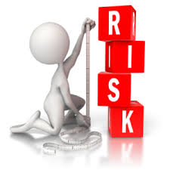
Hazard Identification and
Risk Management Process
1. Identifying hazards
The first step is to identify any hazards in the workplace.
2. Assessing the Risk
Assess the level of risk associated with each hazard. Take into the exposure (how frequently a person or thing is exposed to a hazard), the Likelihood (chance) of harm occurring, and the most likely consequences (injury or damage) if harm was to occur.
3. Controlling the Risks
Some control measures are more effective than others. Control measures can be ranked from the highest level of protection and reliability to the lowest. This ranking is known as the hierarchy of control.
4. Reviewing Risk Controls
Control measures that are put in place to protect
health and safety, should be regularly reviewed to
ensure they remain effective.

Slide 20
Hierarchy of Control
Elimination
Administrative
PPE
Isolate
Substitution
Engineering
remove the hazard from the workplace
Eliminates or Controls the Hazard or Risks
use a different (safer) process, machine or chemical
as much as possible, isolate the hazard or hazardous work practice from people
install guards on machines, put in barriers around hazards
Relies on the person working with the hazards / risks ‘doing the right thing’
use policies, training and signs to warn workers

Slide 21





Control Measures
PPE does not eliminate or control the hazard at the source. It can only limit exposure to the harmful effects of the hazard.
The hazard may require a number of controls to minimise the risk to health and safety.
For example:
Engineering – machine guarding to prevent access to nip points
Administrative – training and competency and safe operating procedures for the task and operation of the plant
PPE – dust mask and hearing protection due to atmospheric contaminants and noise generated from plant operation

Slide 22

Control Measures
Where PPE is necessary to minimise the risk of harm from one hazard, its interaction must be taken into account, as it may not be appropriate and create another.
For example:
Safety glasses may fog up in warm weather affecting clear vision.
  An alternative may be a face shield to allow better ventilation around the face while performing a specific task.

Slide 23
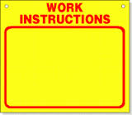

Information on PPE Requirements?
Workers are generally informed of PPE requirements through:
Company induction process
Risk assessments
Manufacturers Instructions
Safety data sheets (SDS)
Standard operating procedures (SOP)
Safe work method statements (SWMS)
Safety management plans (SMP)
Supervision
Training process
PPE signage.

Slide 24
Instructions on PPE Requirements
Examples of where PPE may be required to be worn are:
Entering or working in dust filled atmospheres - safety glasses / goggles, dust masks and respirators.
Entering or working in noisy environments - ear plugs and ear muffs.
Operating hand held vibrating plant and equipment - anti vibration gloves.
Conducting general maintenance activities - gloves, long sleeved shirts, long pants, steel - capped boots, hard hat and safety glasses.
Exposed to potential falling / expelled material - safety glasses and hard hat.
When working at heights - harness and lanyard, static lines.
Working with chemicals and substances – pvc gloves, aprons, safety glasses, and respirators.

Slide 25
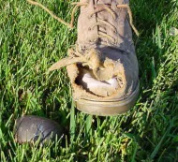
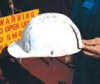
PPE Care and Maintenance
Safety glasses - regularly clean with a soft clean cloth.
Reusable ear plugs – wash in warm soapy water and dry thoroughly with a clean cloth.
Disposable ear plugs – replace with new when taken out of ears.
Disposable dust masks – replace daily or when contaminated.
Gloves – replace when worn / holes occur or become contaminated.
Safety boots – replace when holes occur or steel cap is exposed.
Protective clothing – regularly wash clothing and replace on a wear / tear basis or material is contaminated with chemicals.

Slide 26
Summary
PCBU
Primary duty of care to all workers on site by providing a working environment without risks to health and safety.
Duty to provide PPE where it’s not practicable to eliminate the hazard or control the risk in any other way.
Duty to provide information, instruction and training on the wearing, care and maintenance of PPE.
Supervisors and Team Leaders
Responsible for the day-to-day operations to ensure workers are adequately supervised, working safely and complying with the requirements for wearing / using PPE.
Replace workers PPE when damaged, worn, contaminated or lost.

Slide 27
Summary
Workers
Follow any reasonable instruction from Supervision while at work.
Should not place themselves or any one else at risk of harm through his or her acts or omissions (actions or words).
Wear supplied PPE identified to protect them from hazards and risks associate with their work.
Inform their Supervision when PPE requires replacement or repair.
Care for and maintain their PPE within their limits of control.
Comply with all blue and white mandatory PPE signage where sign posted or documented.

Slide 28
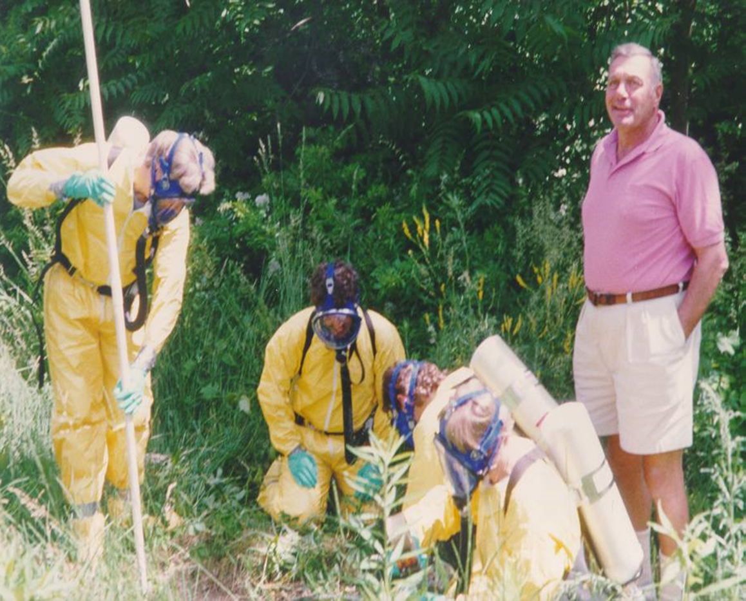
This looks Interesting?

Slide 29
Further Assistance
MAQOHSC Work Health and Safety Specialists are available to provide further on-site support and assistance on all Work Health and Safety matters.
MAQOHSC Work Health and Safety Specialists can be contacted via our online support request form available on our website at www.maqohsc.sa.gov.au or email maqohsc@sa.gov.au.
Work Health and Safety Legislation, Codes of Practice, fact sheets, Health and Safety Representatives (HSR) information and guides can be found at the following websites:
SafeWork SA – www.safework.sa.gov.au or call 1300 365 255
Safe Work Australia – www.safeworkaustralia.gov.au or call 1300 551 832

